Slide 1
Meta-Programming for Android Project
Learn how to generate code using KSP and KotlinPoet
For your Android Project
Jimly Asshiddiqy
Business And Integration Architecture – Senior Analyst

Slide 2
Agenda
1.
Background
Why do we care about meta-programming?
2.
Use Case
A steppingstone to what we will be doing.
3.
What to build?
What can we do with meta-programming?
4.
Input
Declaring code as an input for meta-programming.
5.
Process
Where we will be doing the code generation.
6.
Output
Observe how the result code will look like.
7.
... Profit?
What can we expect when using code generation for our project.

Slide 3
“The Best Code is No Code at All” - Jeff Atwood

Slide 4
But why?
Why is it better to write less code? Because code …
Requires periodic maintenance
The more code you have, the more places there are for bugs to hide
If you must refactor, there’s more stuff to move around
More code sometimes mean longer checkouts or compile time
To make more code requires more developers

Slide 5
Introducing Meta-Programming
What meta-programming really is?
A computer programming technique in which computer programs can treat other program as their data.
It means a program can be designed to read, generate, analyse, and transform other programs, and even modify itself while running.
One of the sample of it is code generation.

Slide 6
Code Generation in Kotlin
PROCESS
Using library/tools to process code into new code
INPUT
Our .kt files
OUTPUT
New generated code to use

Slide 7
What tools to use?
KSP
KotlinPoet
Library for developing lightweight compiler plugin.
We will use it to resolve out .kt files and the code inside it.
Developed and maintained by Google
Kotlin and Java library for generating .kt source files.
It contains utility function to build Kotlin code.
Developed and maintained by Square

Slide 8
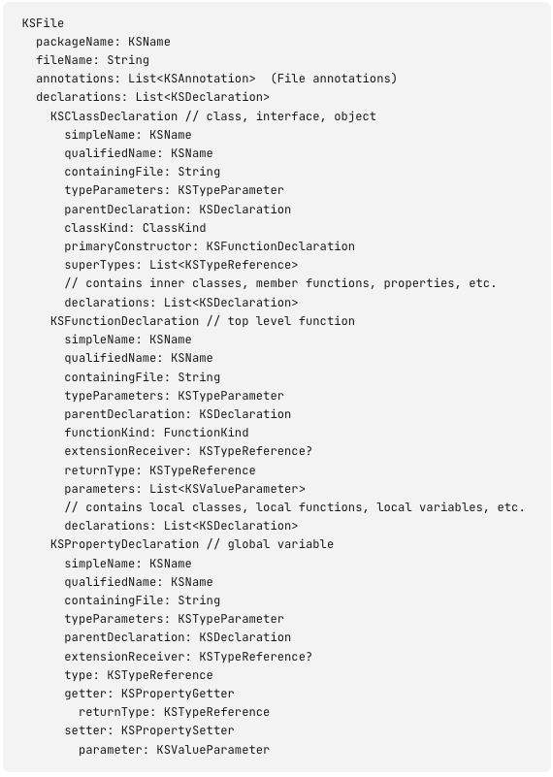
More about KSP
Have a powerful API called Resolver,
getAllFiles
getSymbolsWithAnnotation
getDeclarationsFromPackage
Limitations﻿
Examining expression-level information of source code.
Modifying source code.
100% compatibility with the Java Annotation Processing API.

Slide 9
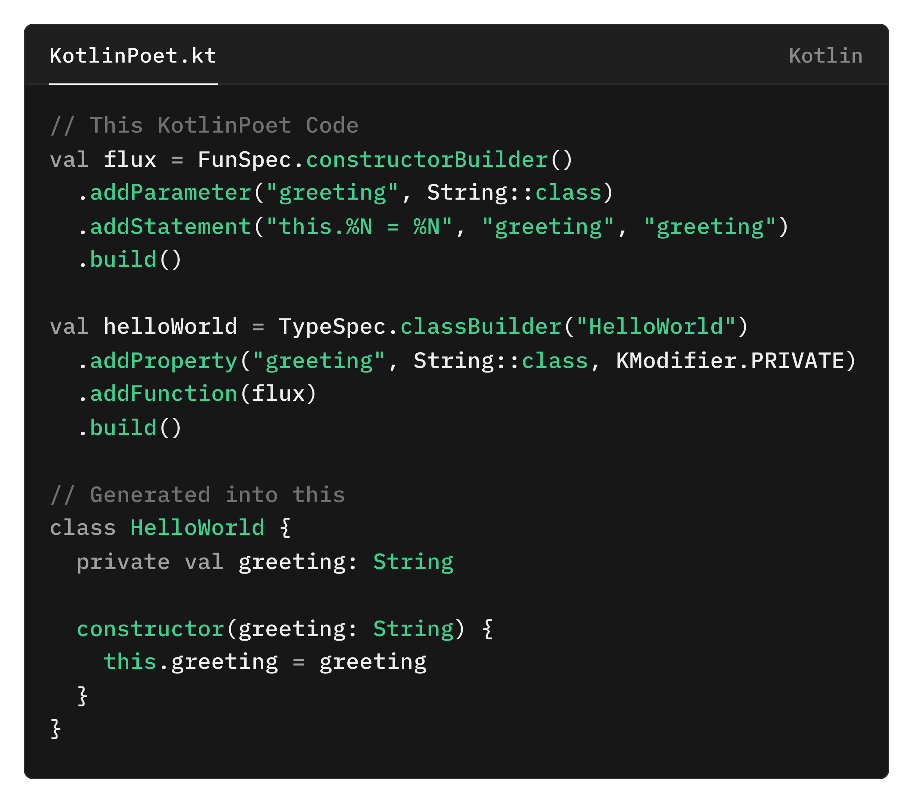
More about KotlinPoet
KotlinPoet uses builder pattern and mutable Kotlin Object for a friendlier API, such as:
FileSpec
TypeSpec
FunSpec
addStatement
addCode
PropertySpec

Slide 10
Symbol Processor
.kt files
Process
Generated code
KSP’s Resolver
define the Input
KotlinPoet generate specs for the code
KSP’s CodeGenerator
generate the code

Slide 11
Sample Use Case
What we will be doing?

Slide 12
Ground Rule
For sample project, we will be making:
Android Application
Using Jetpack Compose as UI Framework
Using Navigation Component for navigating between screens
Using the new type-safe navigation

Slide 13
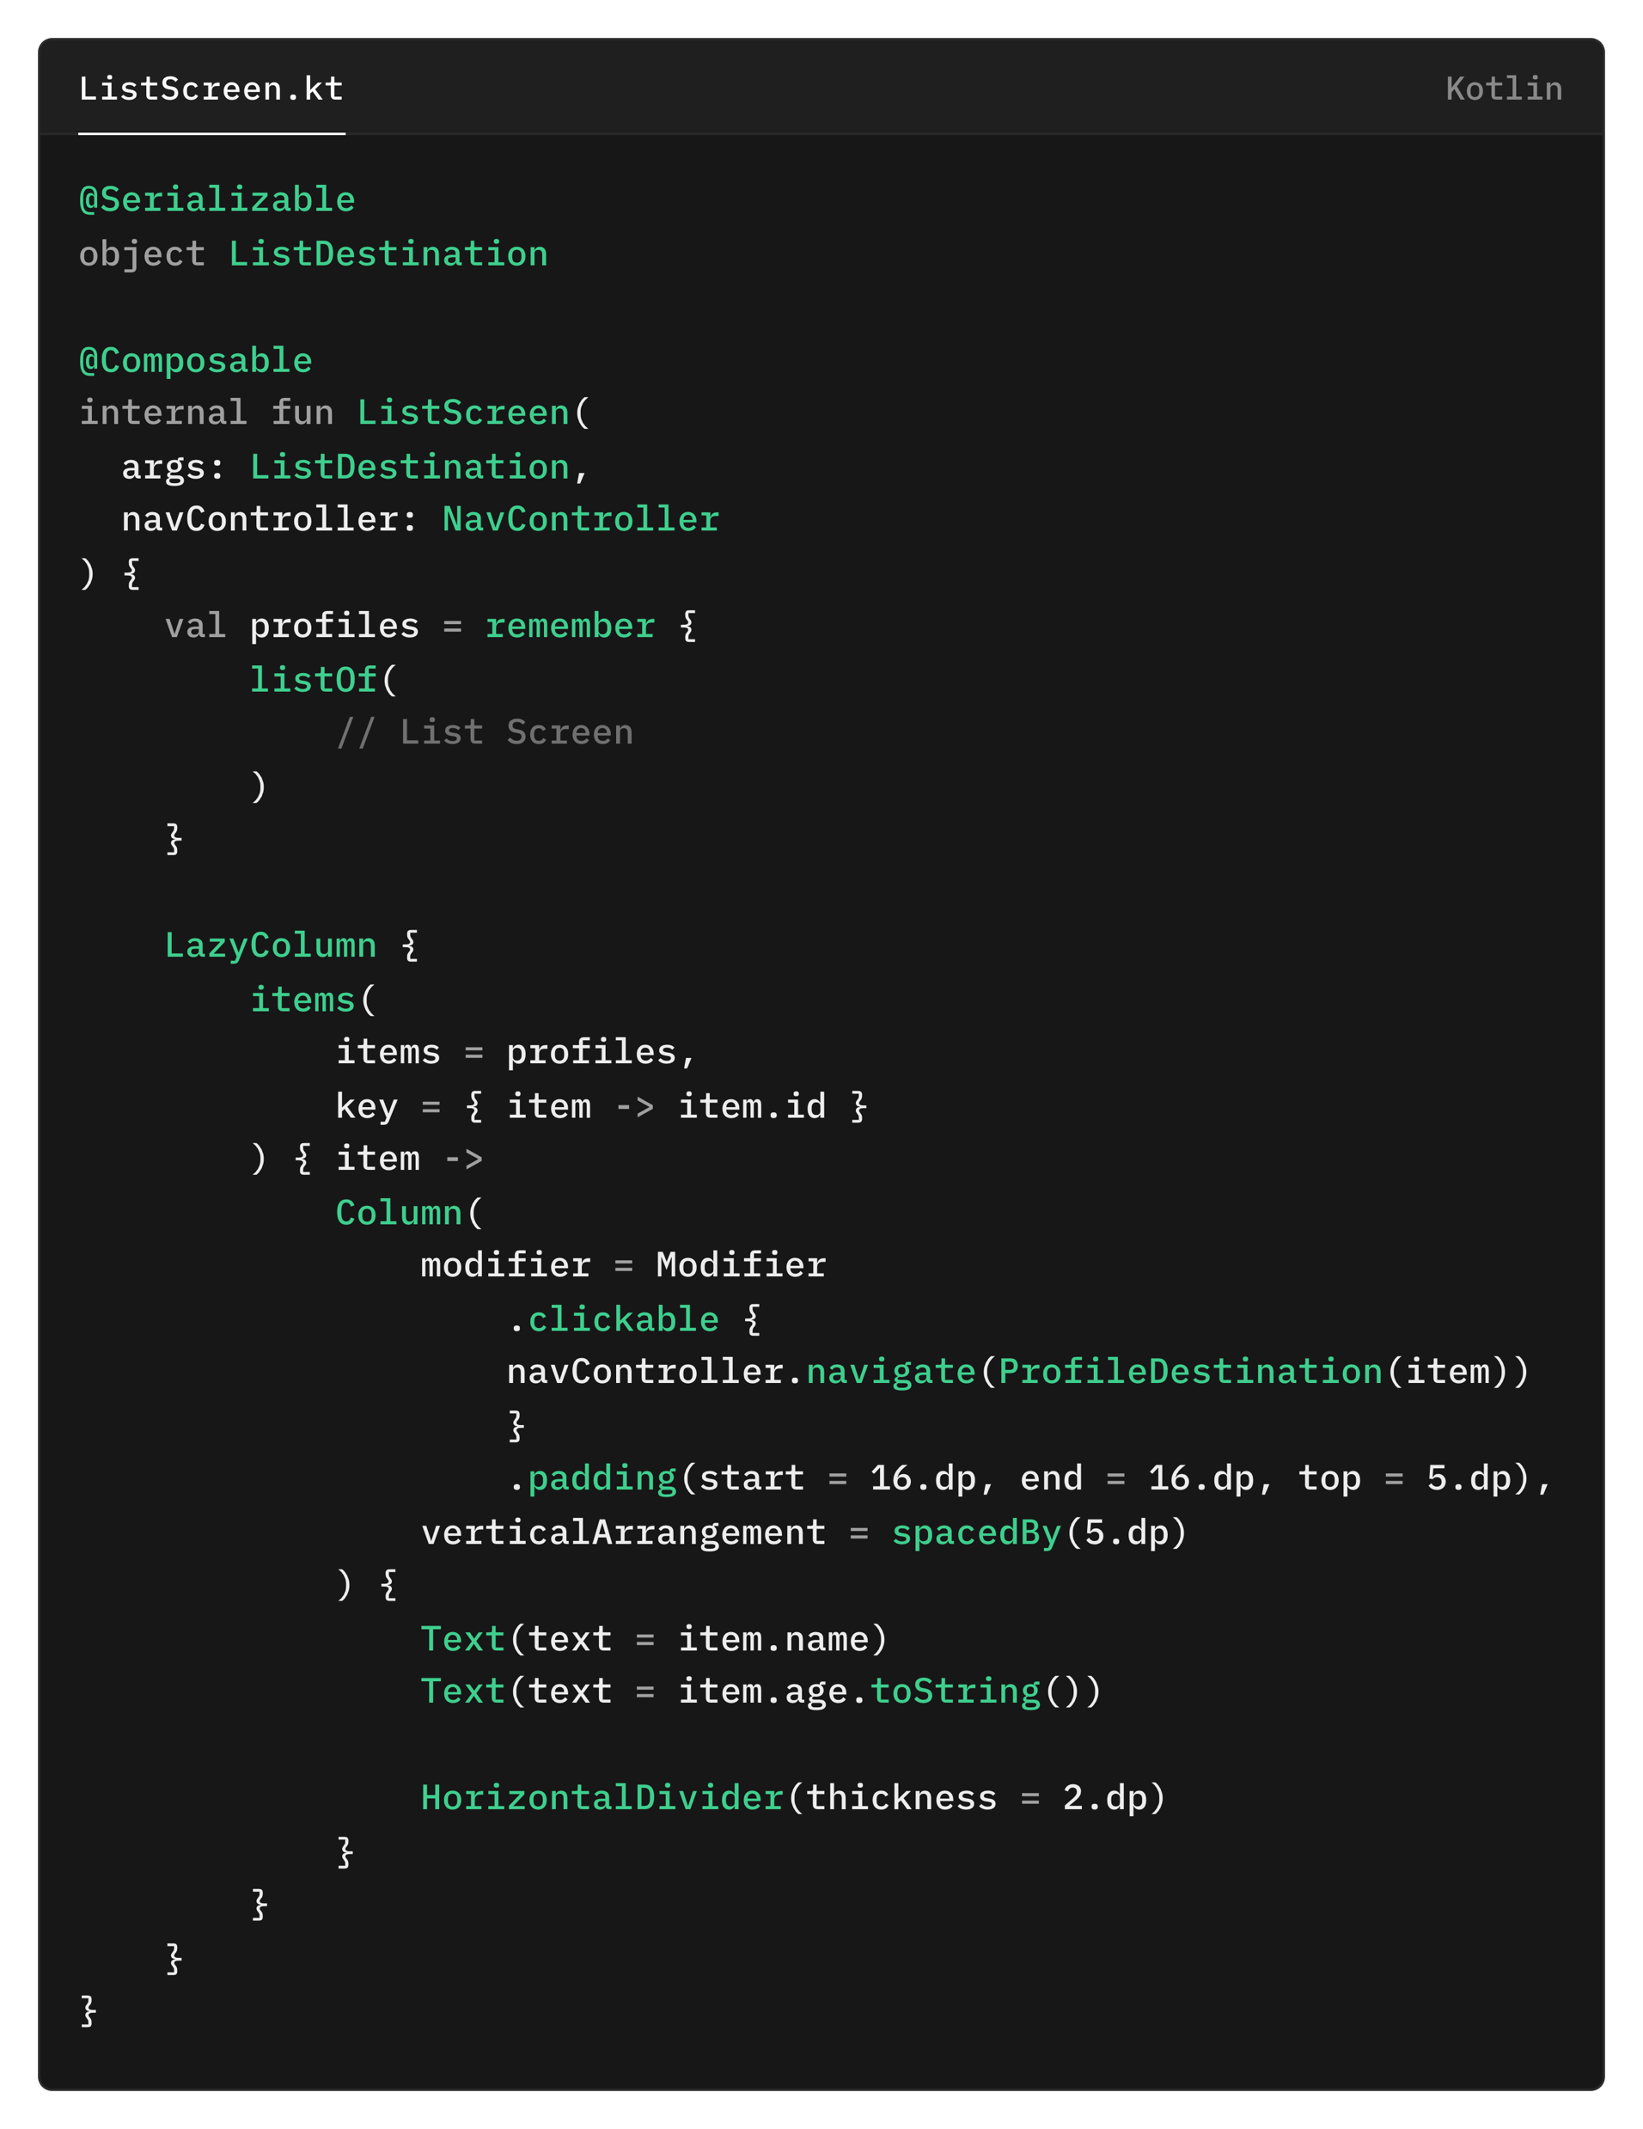
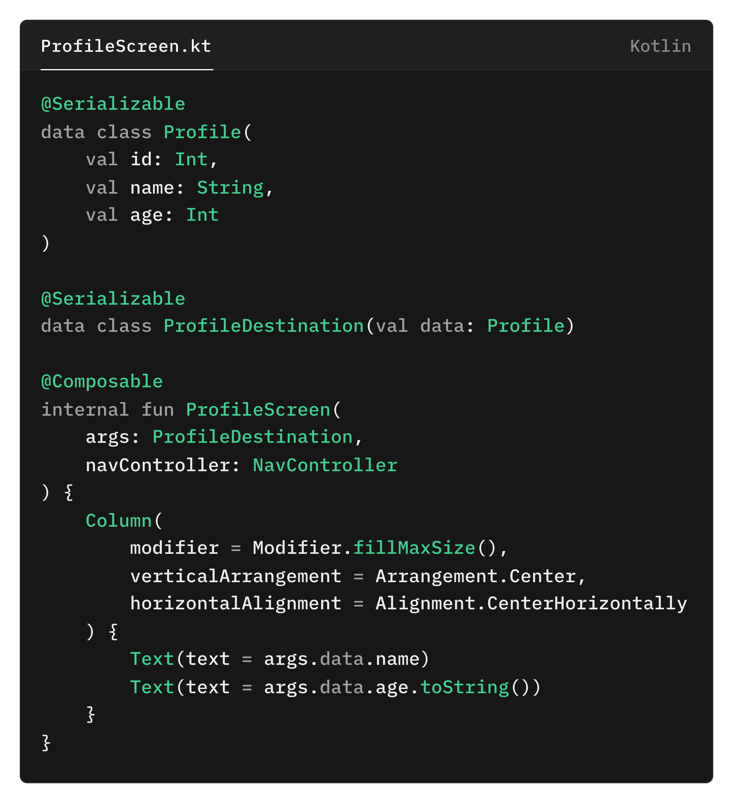
Screen Destinations
Each screen have
exactly two parameters
Route instance for the screen
NavController instance for navigation

Slide 14
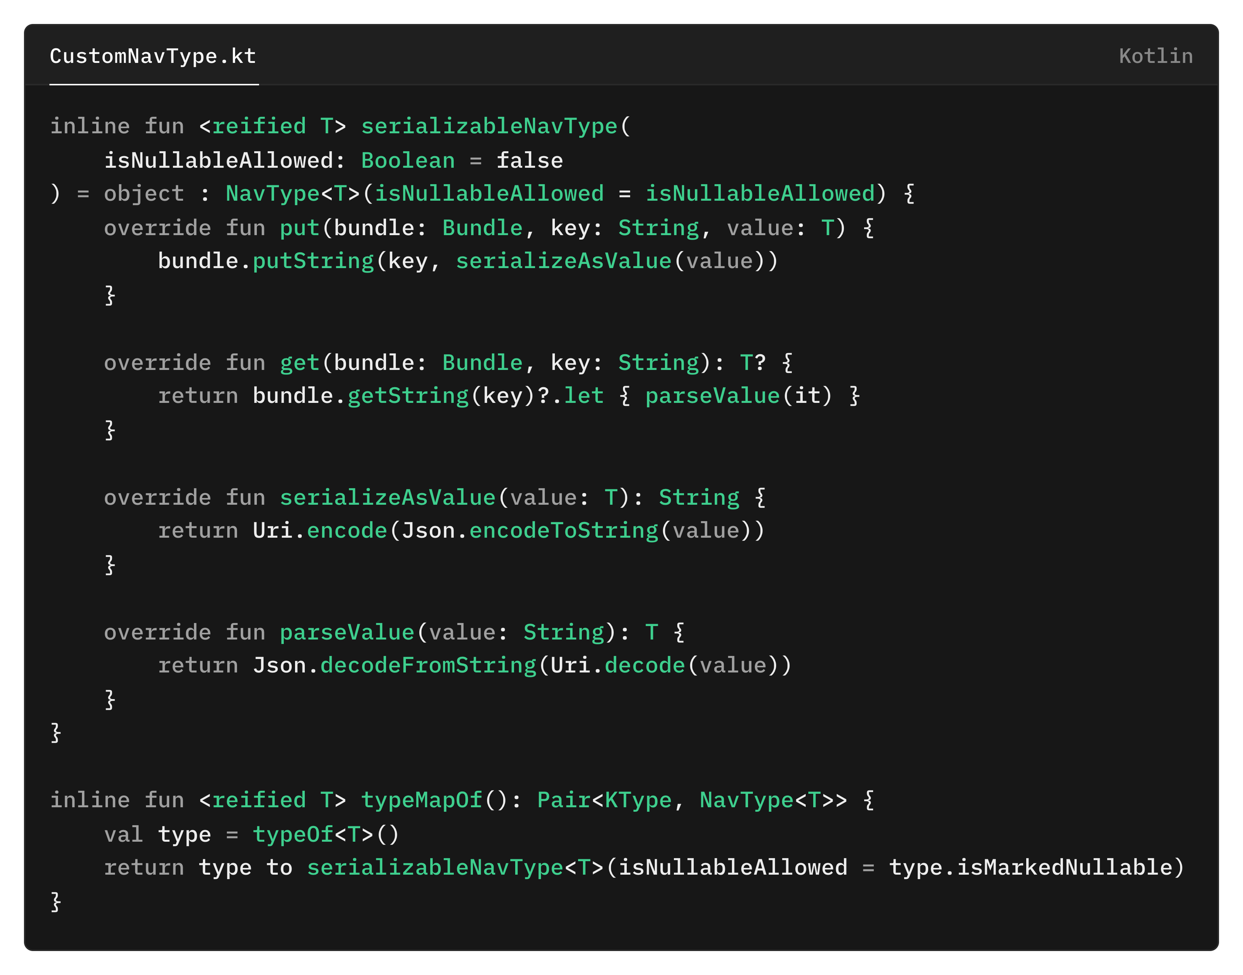
Utility class for custom NavTypes
Global function to provide NavType for the typeMap

Slide 15
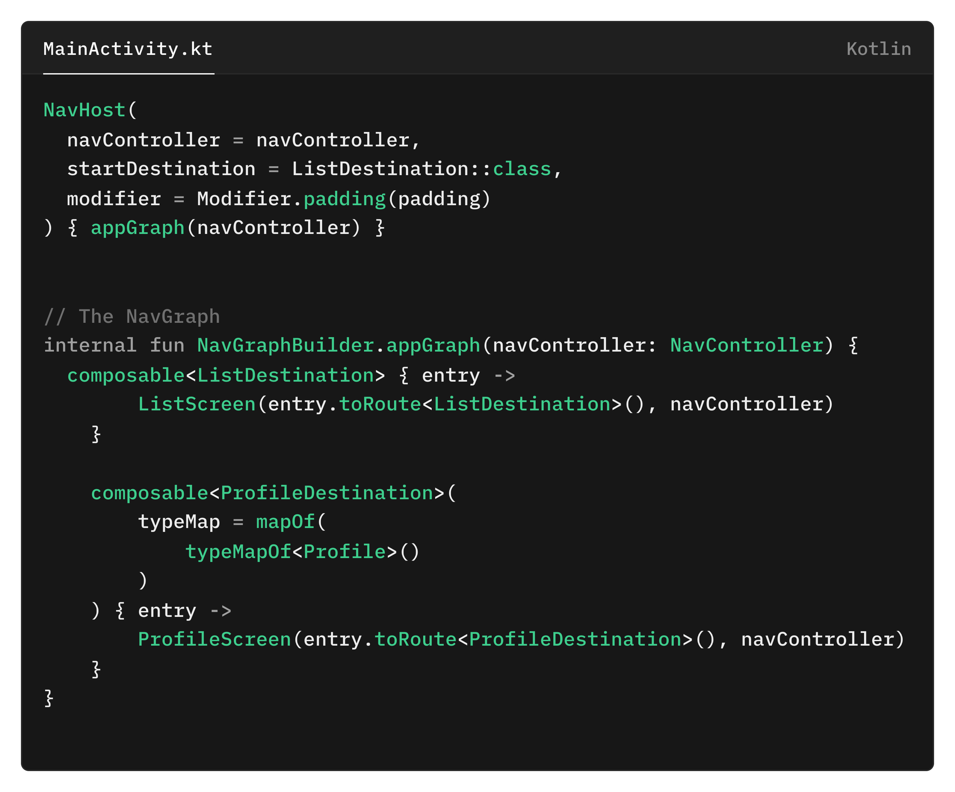
NavGraph

Slide 16
Let’s automate it! Using Meta-Programming
The code works!
But is that the best we can do?

Slide 17
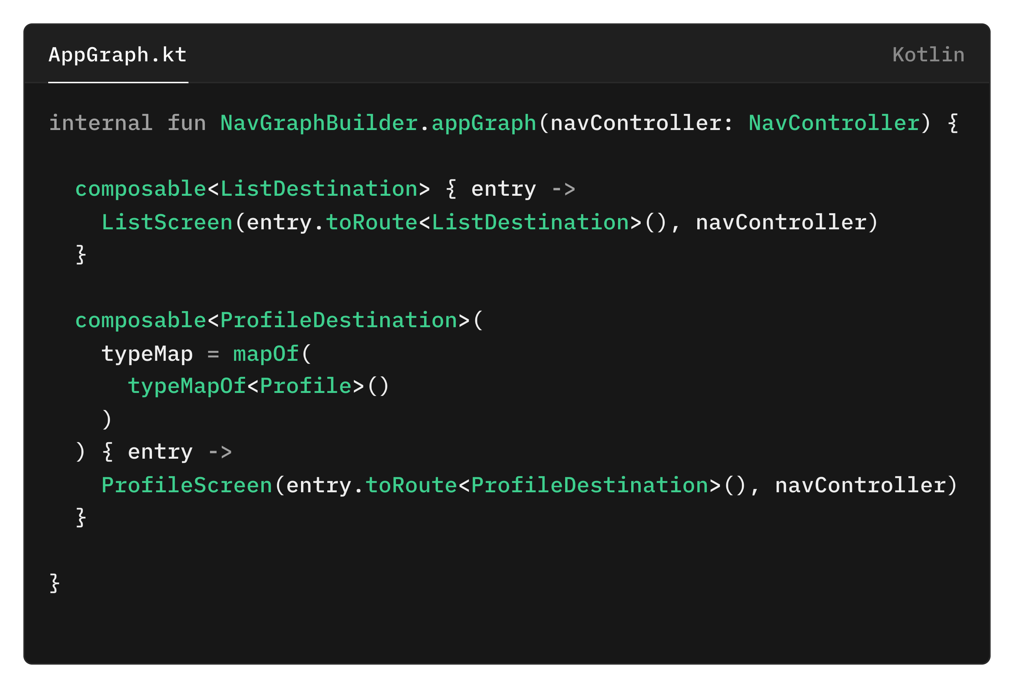
What we want to achieve?
Read all the screen destinations and for each destinations add this code blocks.
Need a way to incorporatee the Destination class with the Screen Function.
If there’s unsupported NavTypes in the Route, add typeMap parameter with value map from Route constructor.

Slide 18
Project Structure
:app
module
:annotation-processor module

Slide 19
INPUT
How we define which code to use as our input.

Slide 20
Declaring input
Which code can be declared as an input?
Technically all your code can be used as input, but not all of them will be helpful and needed for your use case.
So how to set an input for our processor?
The easiest way probably is by annotating the code you want to use as an input.
Keyword: Annotation Class

Slide 21
Annotation?
What is annotation?
Annotations are means of attaching metadata to code.
It gives more context to the code.
Which purpose does it provide?
Code Documentation
Compile-Time Checks
Build time / run time processing
Annotation Samples
Some annotation you probably already know/use:
@Deprecated
@Throws
@Test
@Suppress

Slide 22
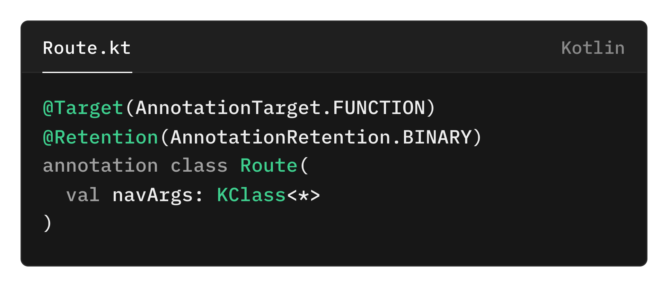
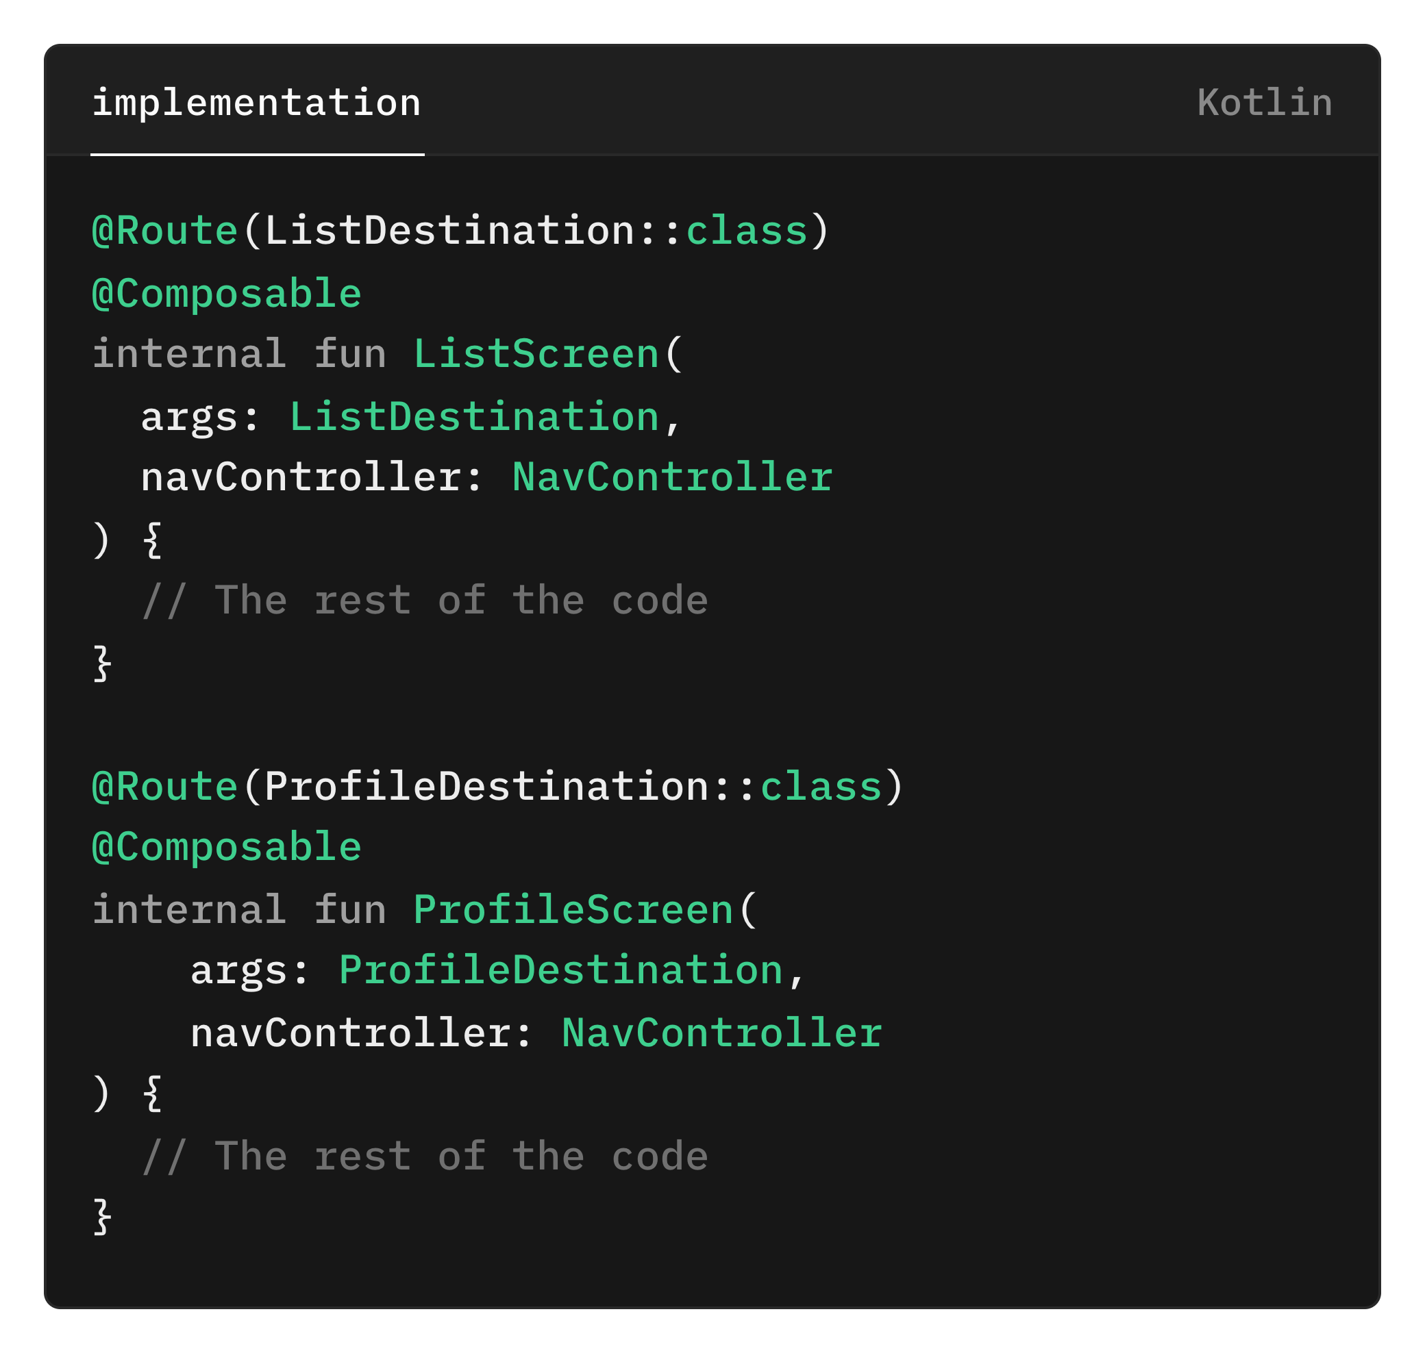
Let’s make our own custom annotation
Target: Where the annotation can be applied
Retention: Determine whether the annotation is stored in binary output and visible by reflection
navArgs: Route class for the screen.
This is how we will link the destination with the screen.

Slide 23
PROCESS
Let’s make our own KSP library!
Turn the oven on and let’s cooking!

Slide 24
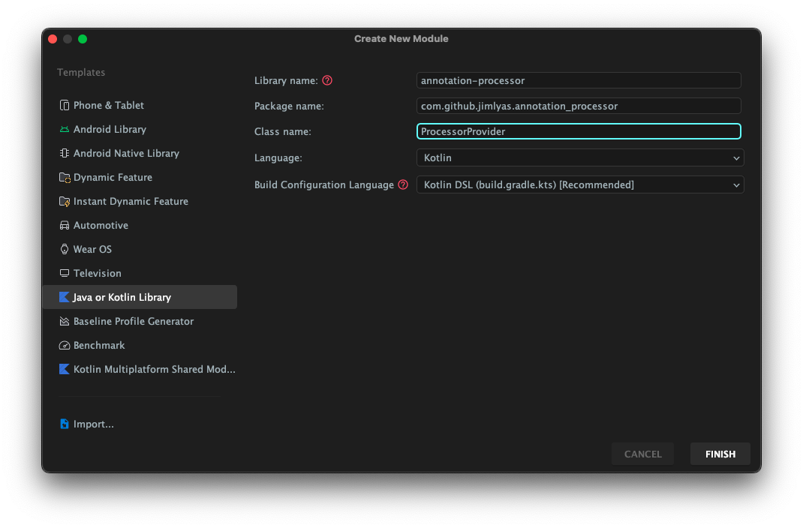
New module
In Android Studio Toolbar:
File > New > New Module
And choose as follow:

Slide 25
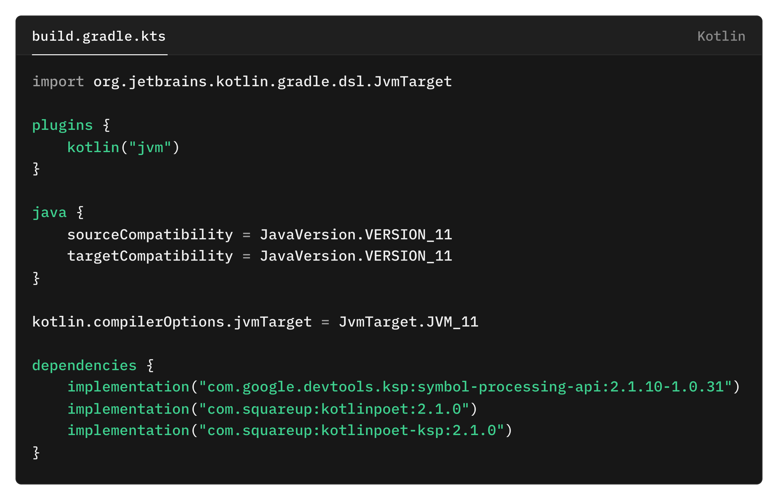
Gradle Setup

Slide 26
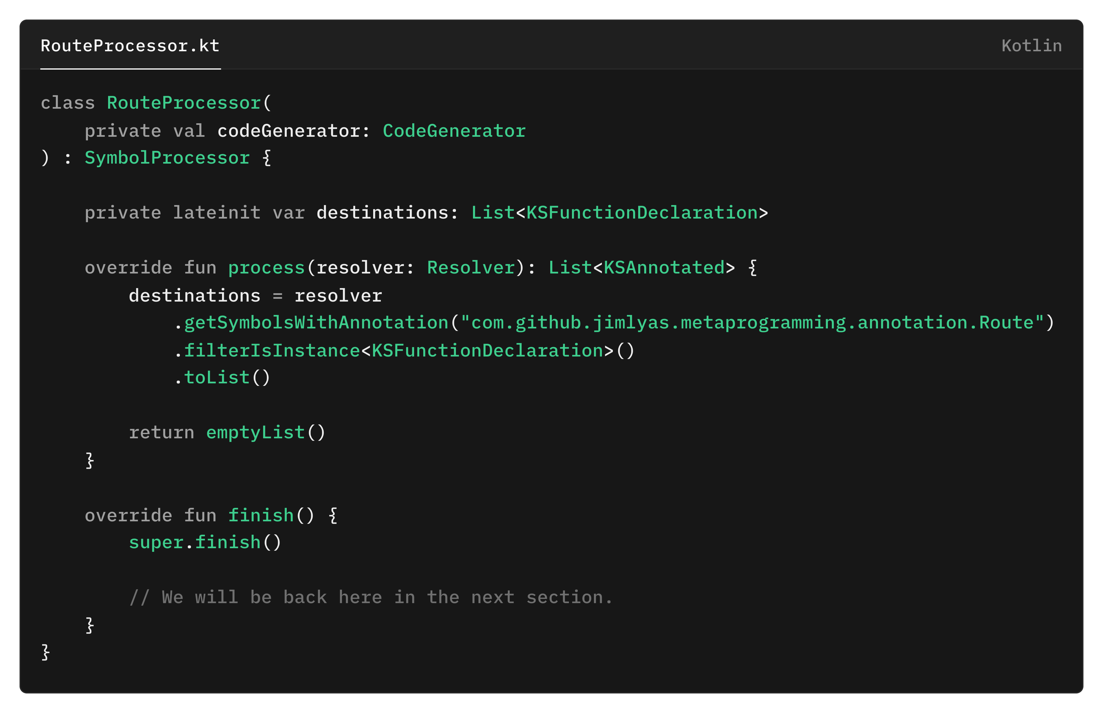
Making the processor class – KSP
This list will host our Composable function.
Filter any Symbols with our annotation.
It took qualified name of the annotation as parameter.
Filter out any other declaration, because we only need KSFunctionDeclaration.

Slide 27
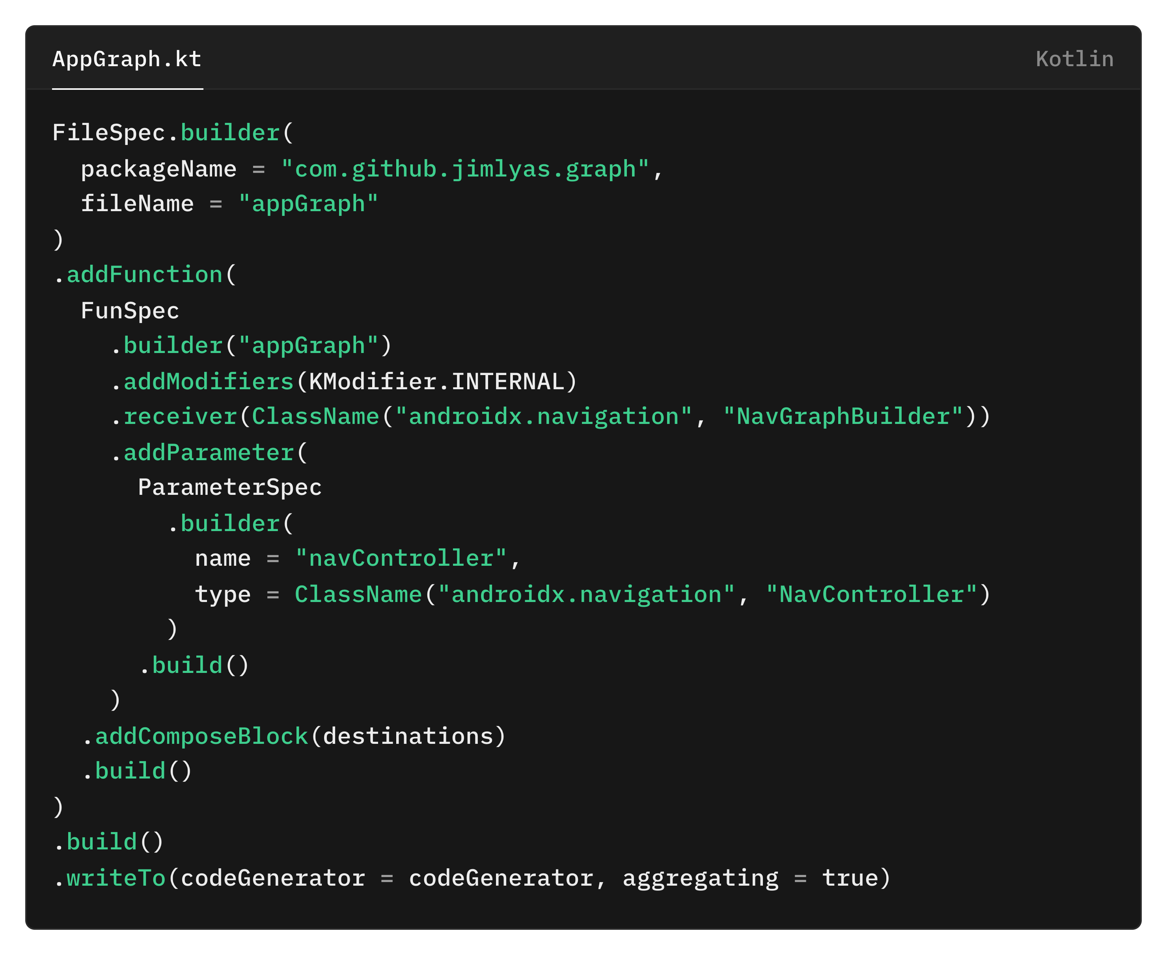
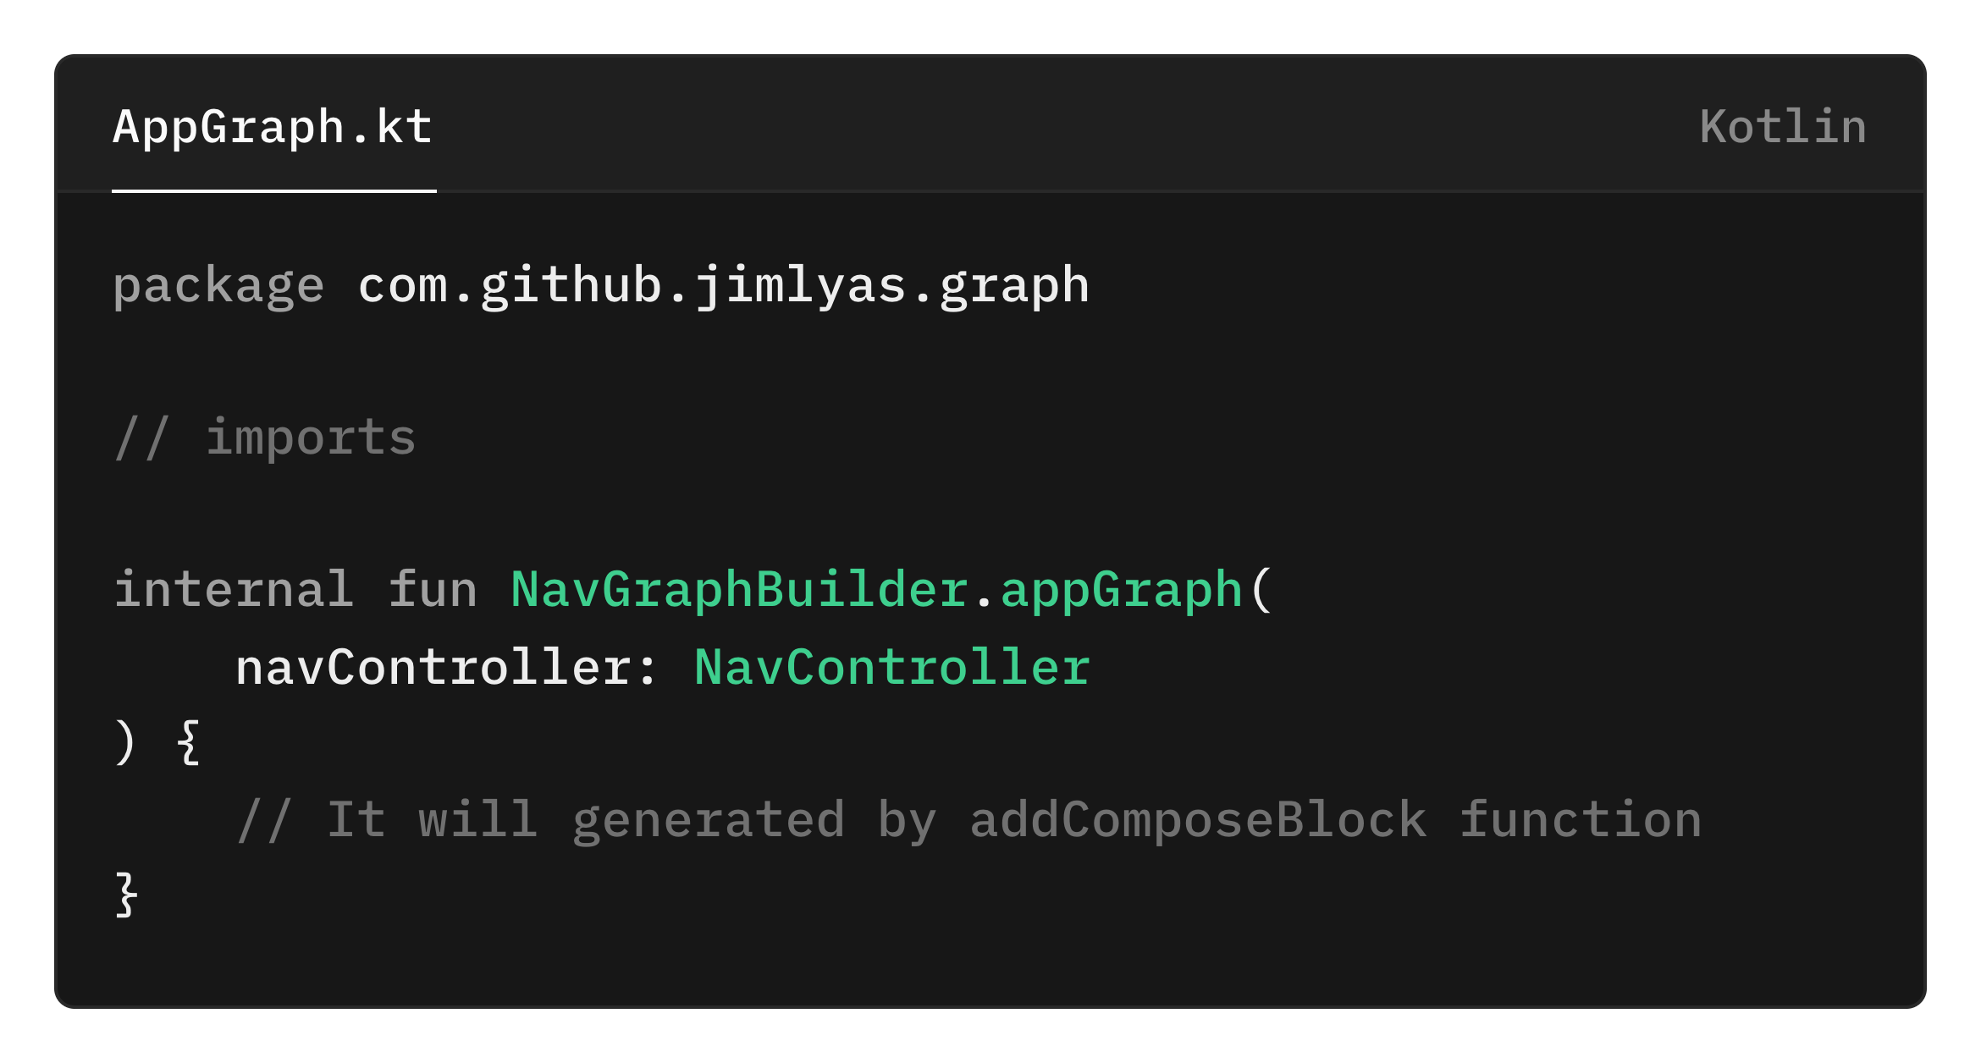
Inside the finish() function – KotlinPoet
Reference of what we want to build:
We will make this extension function later for building the code block for the appGraph function

Slide 28
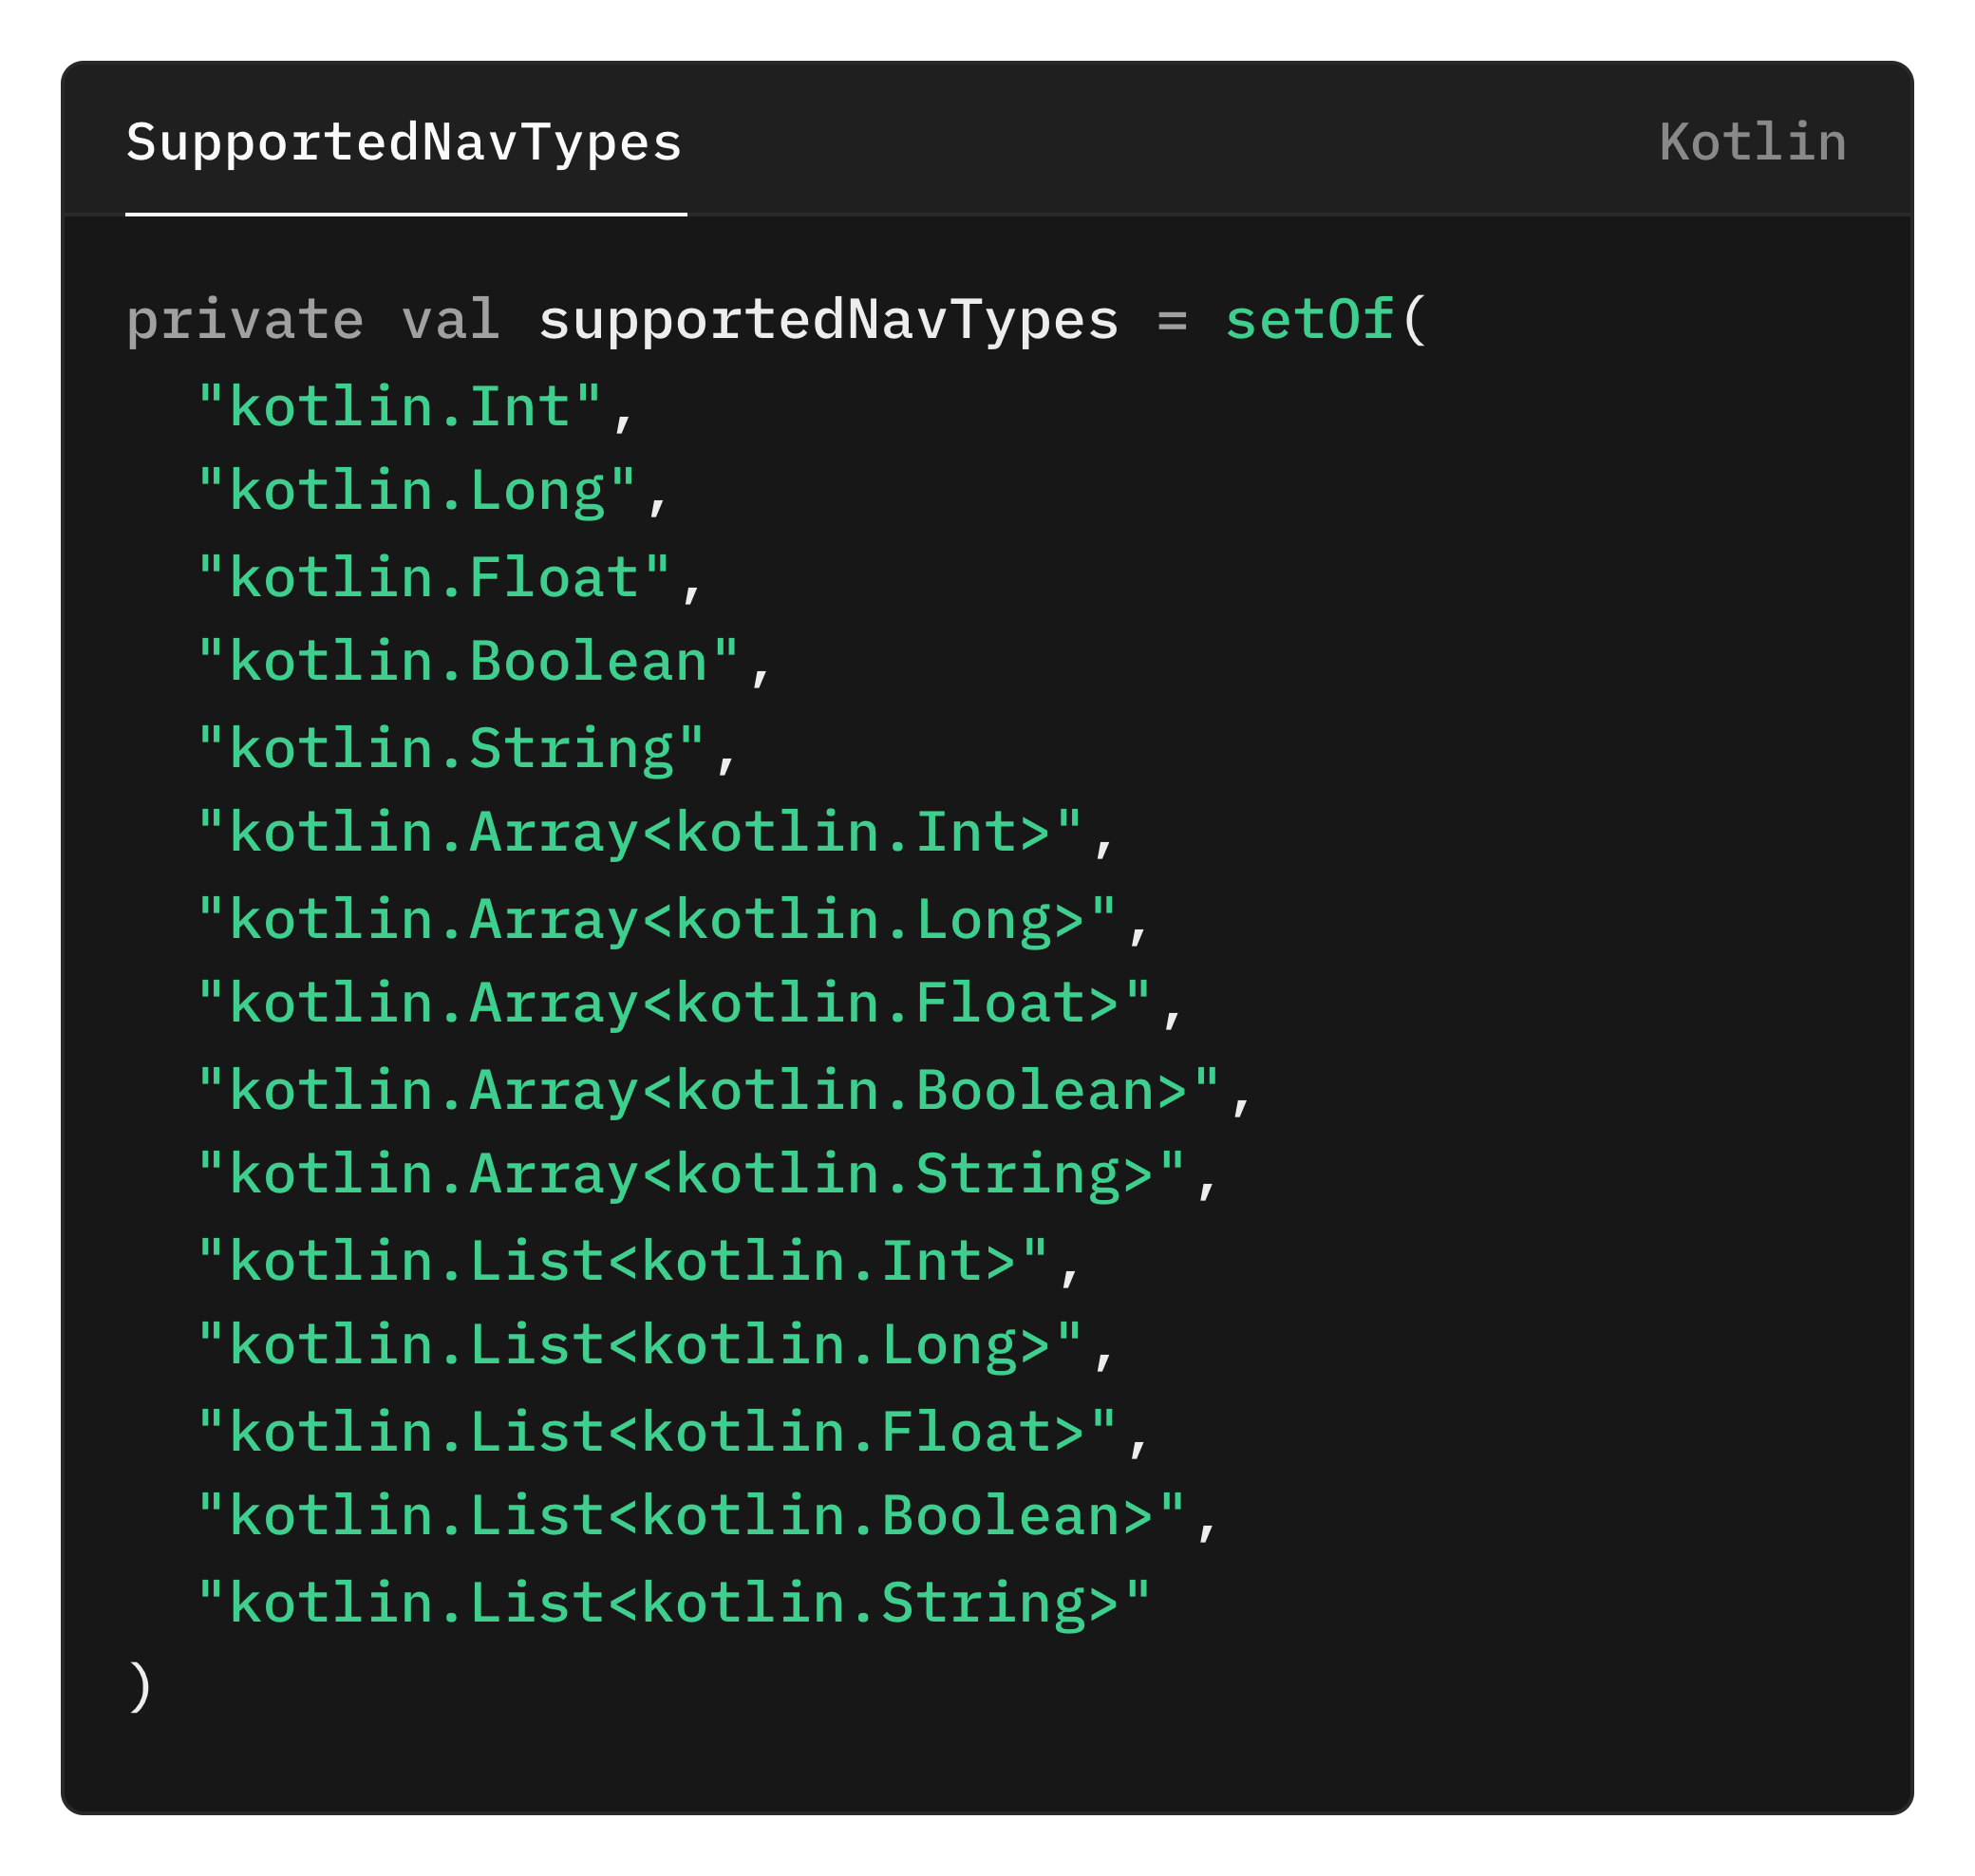
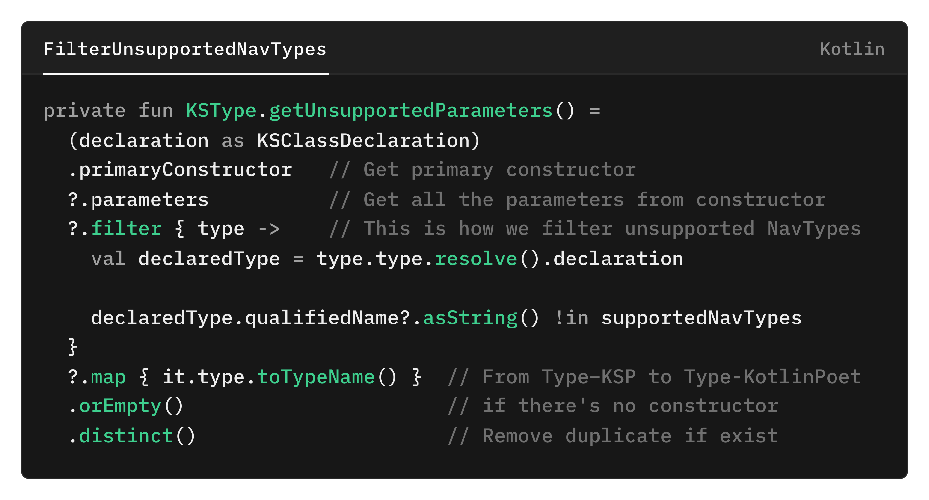
Some helper function first!

Slide 29
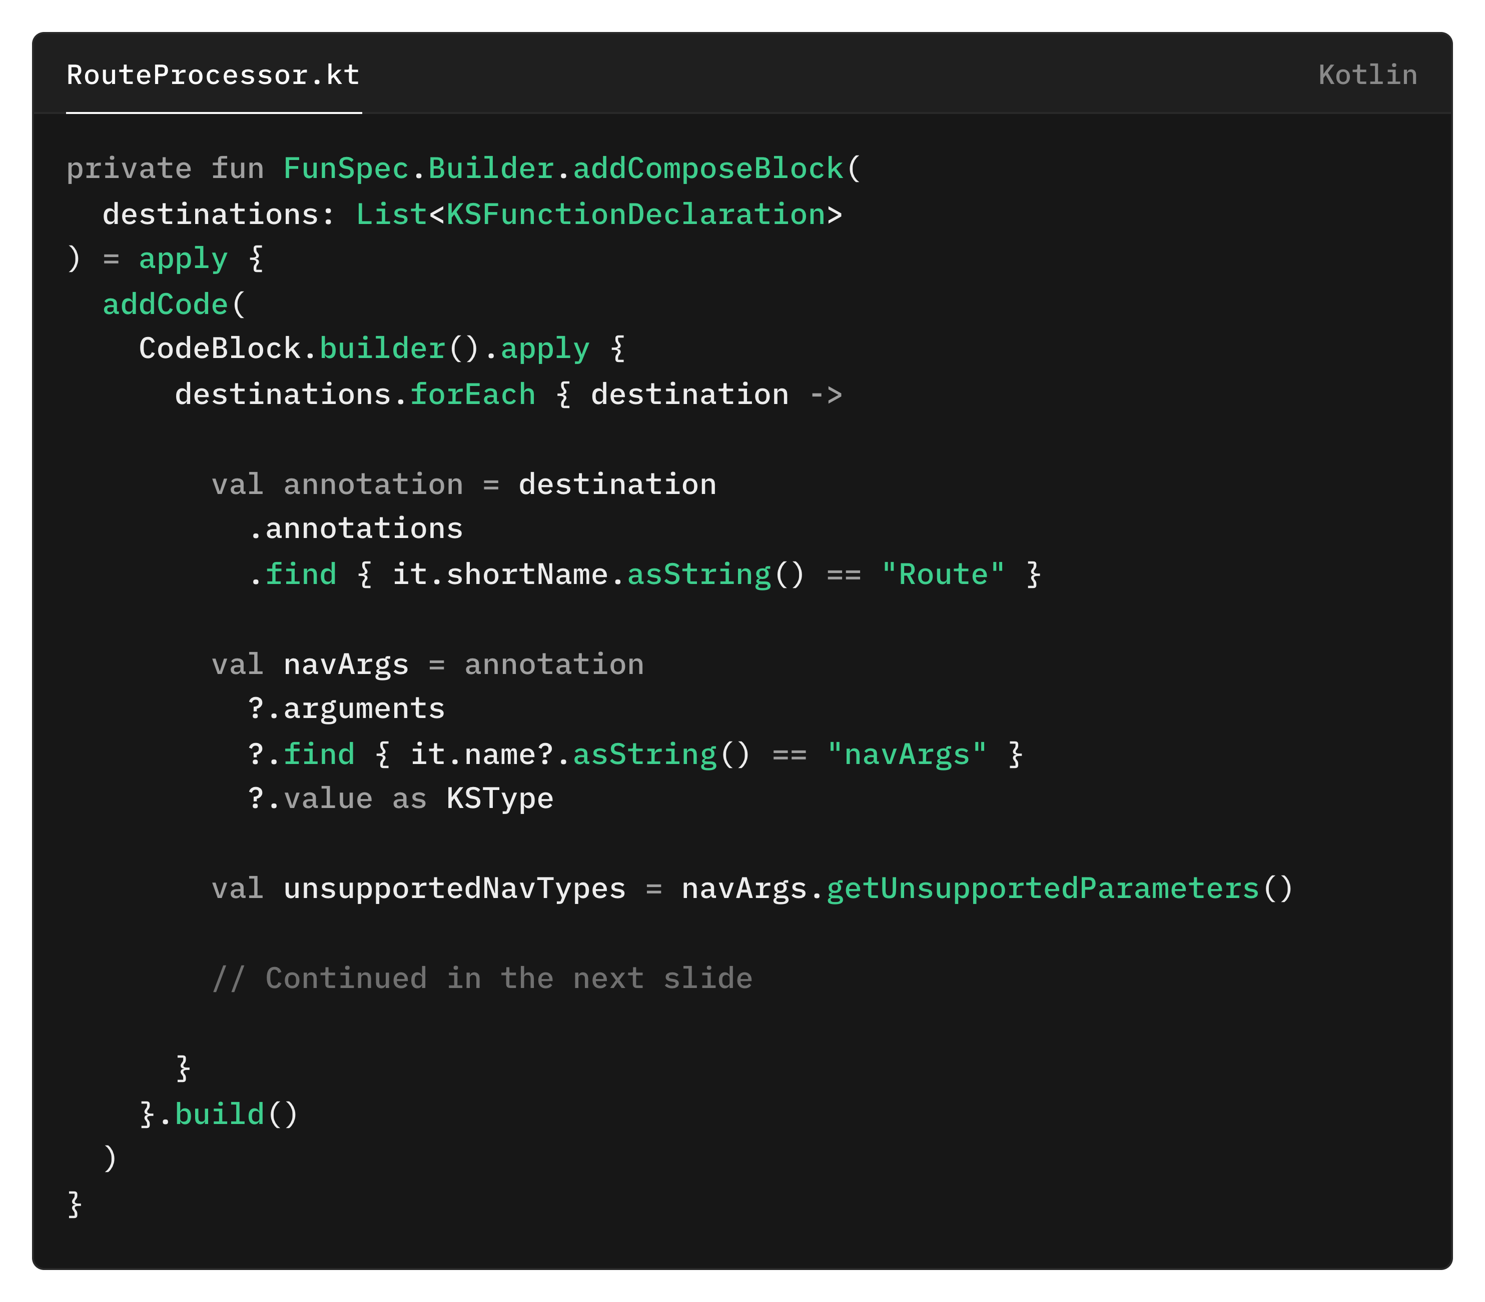
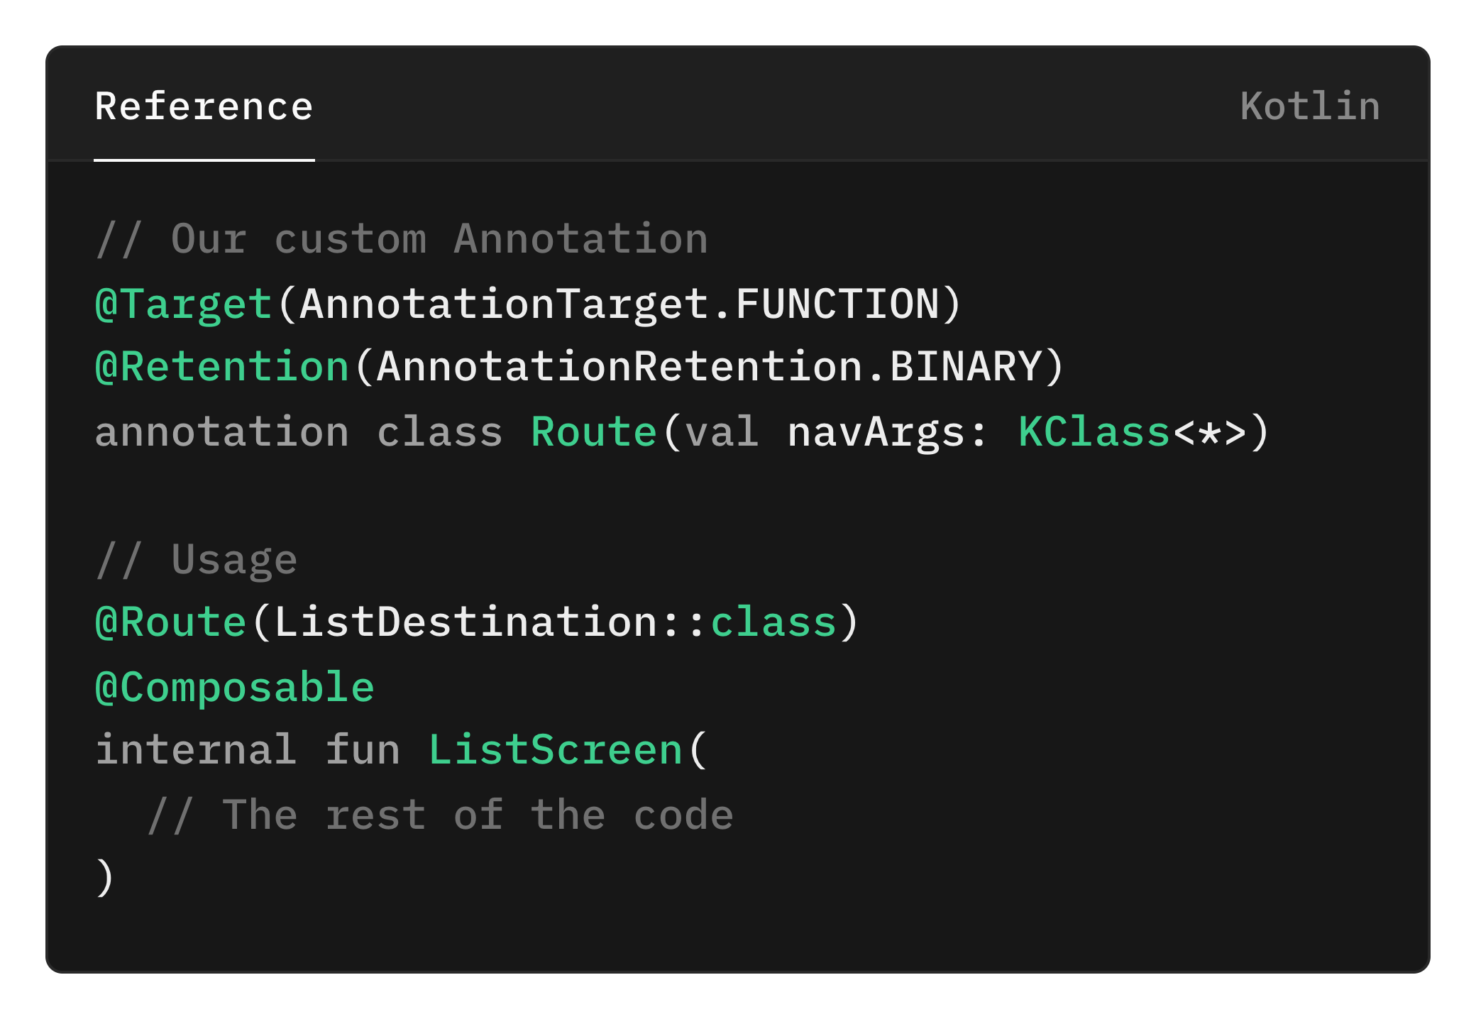
addComposeBlock function
Get the annotation instance from the Composable function
Get the argument from navArgs from route annotation
List of unsupported NavType

Slide 30
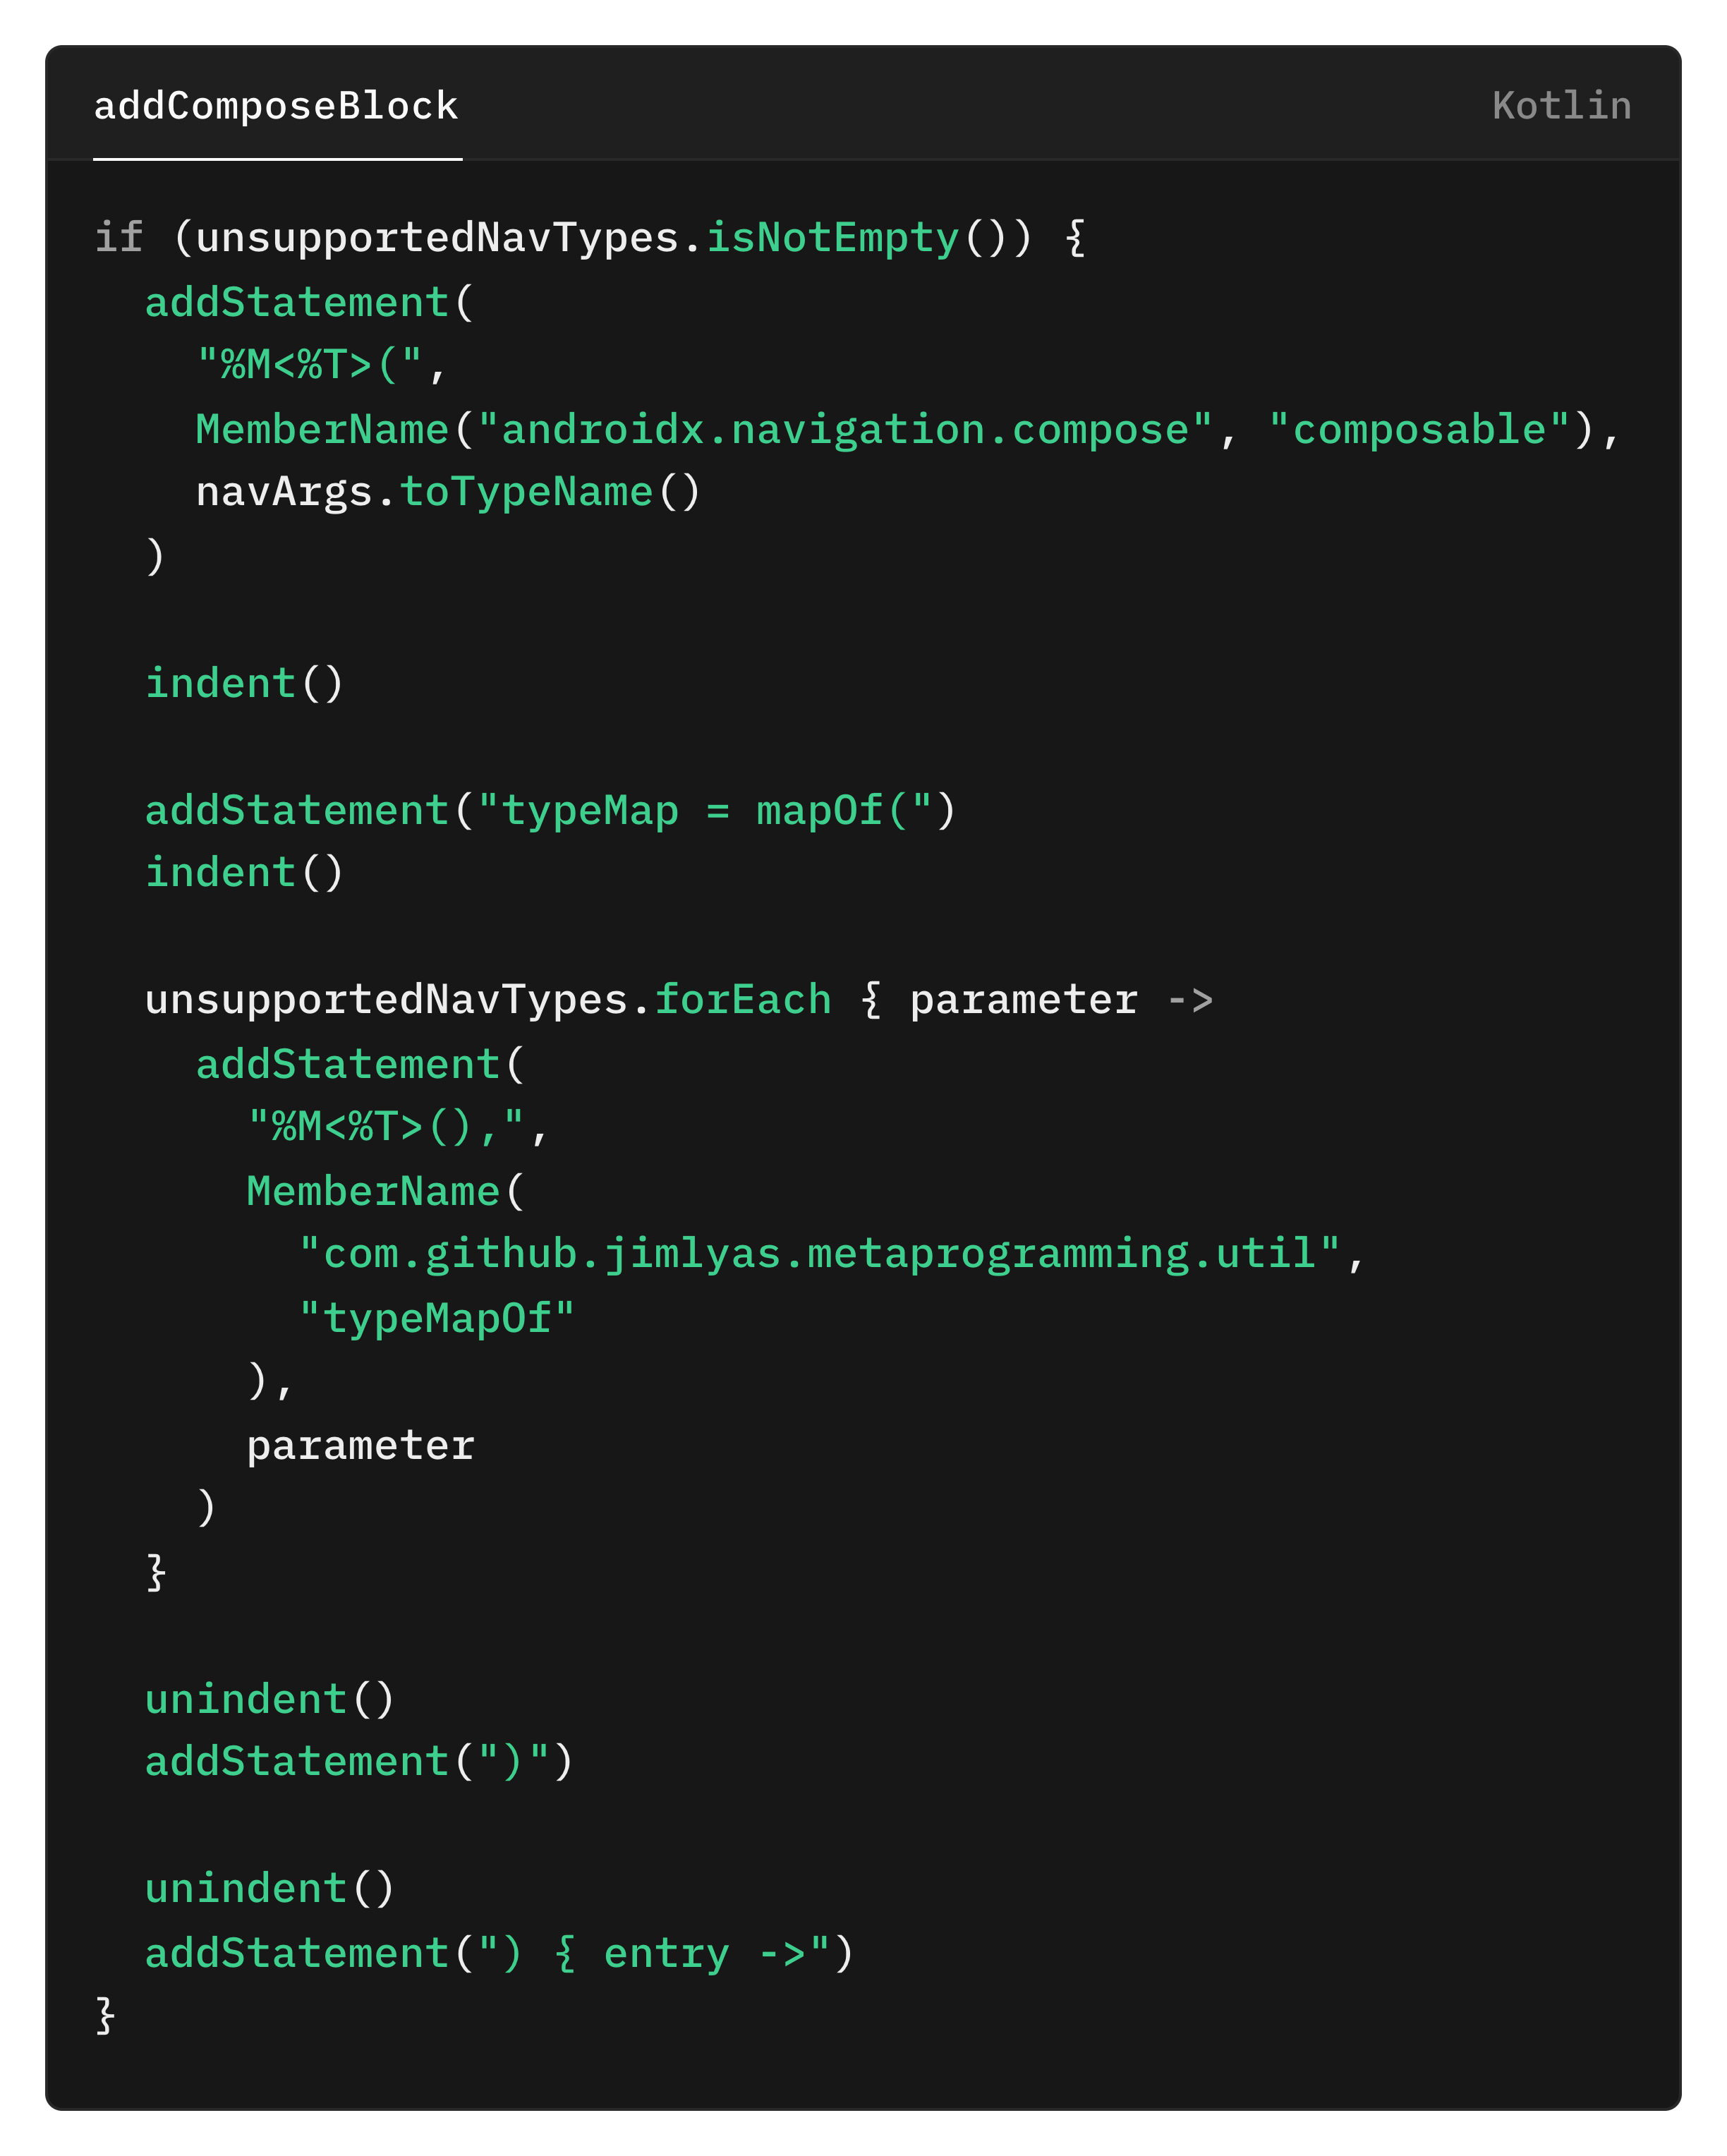
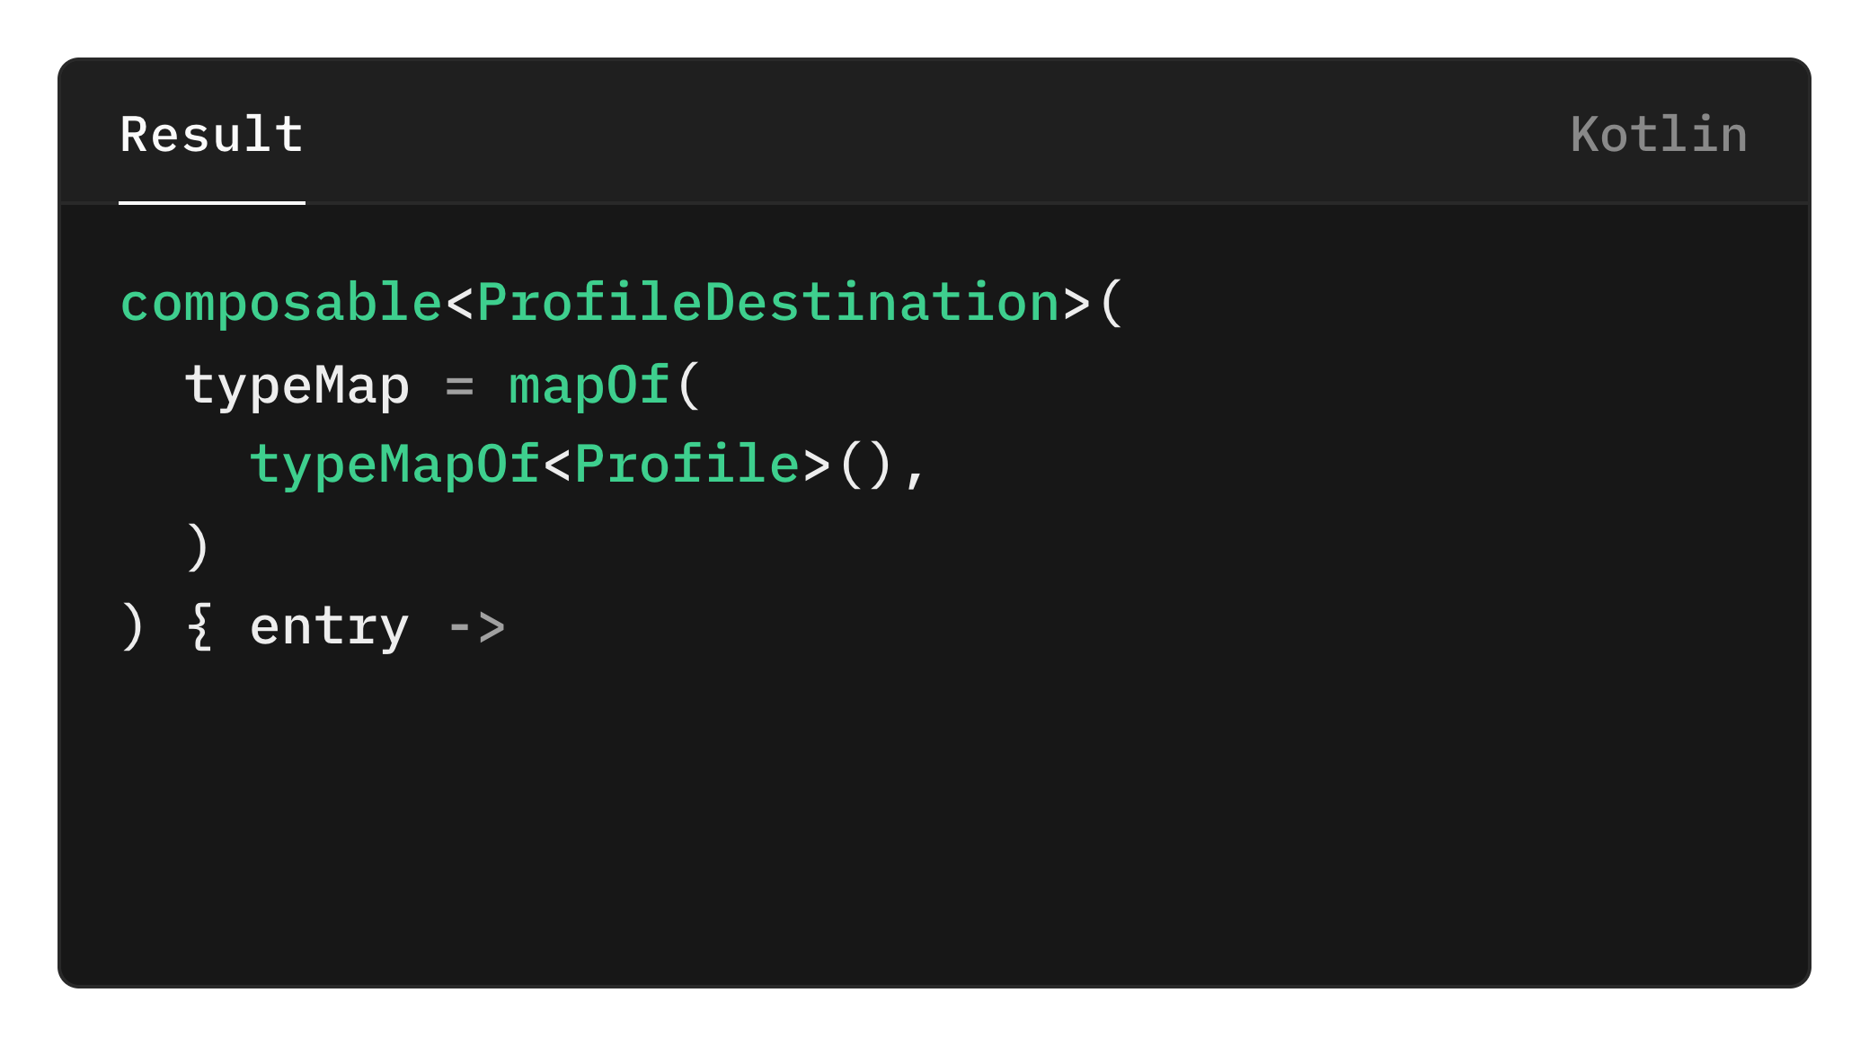

Slide 31
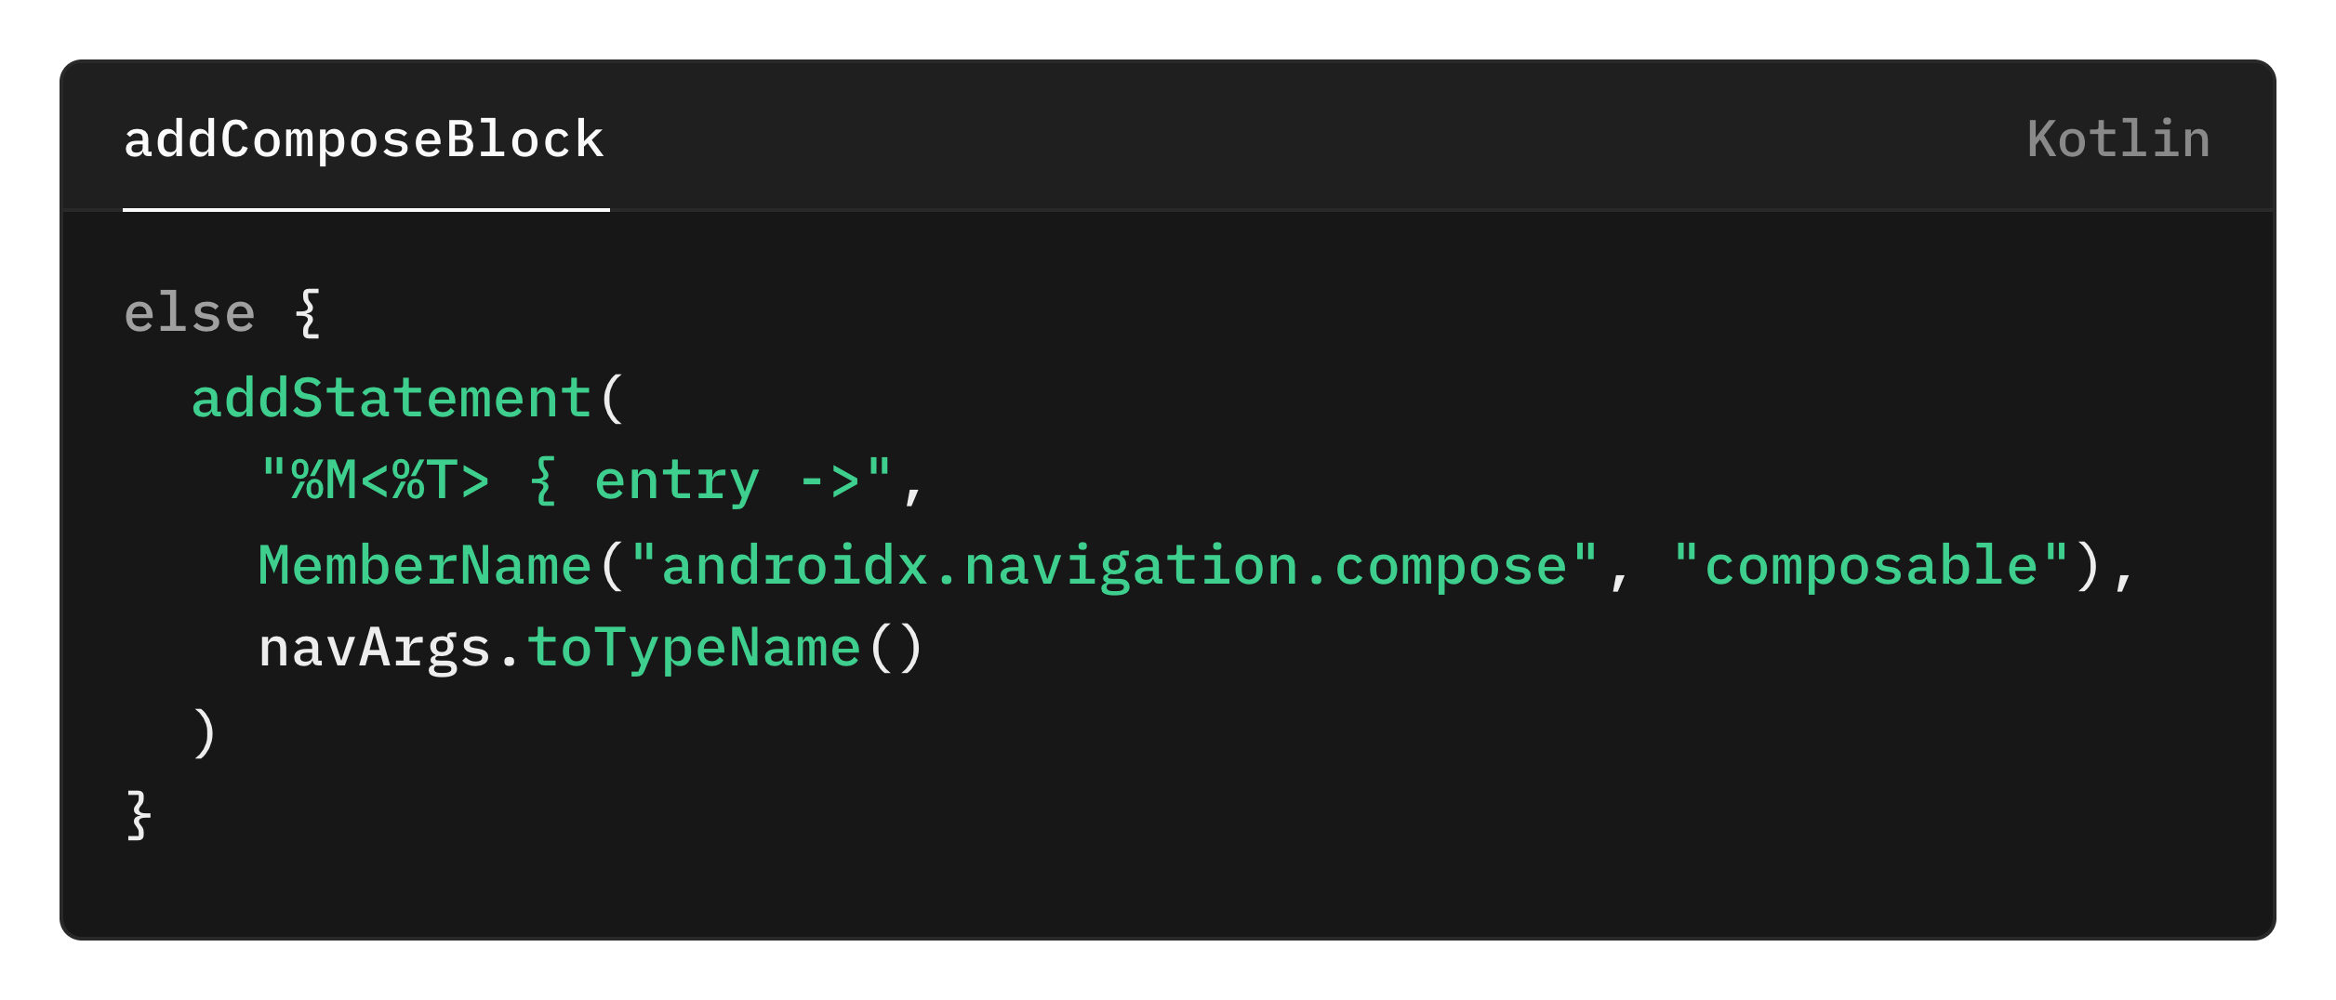
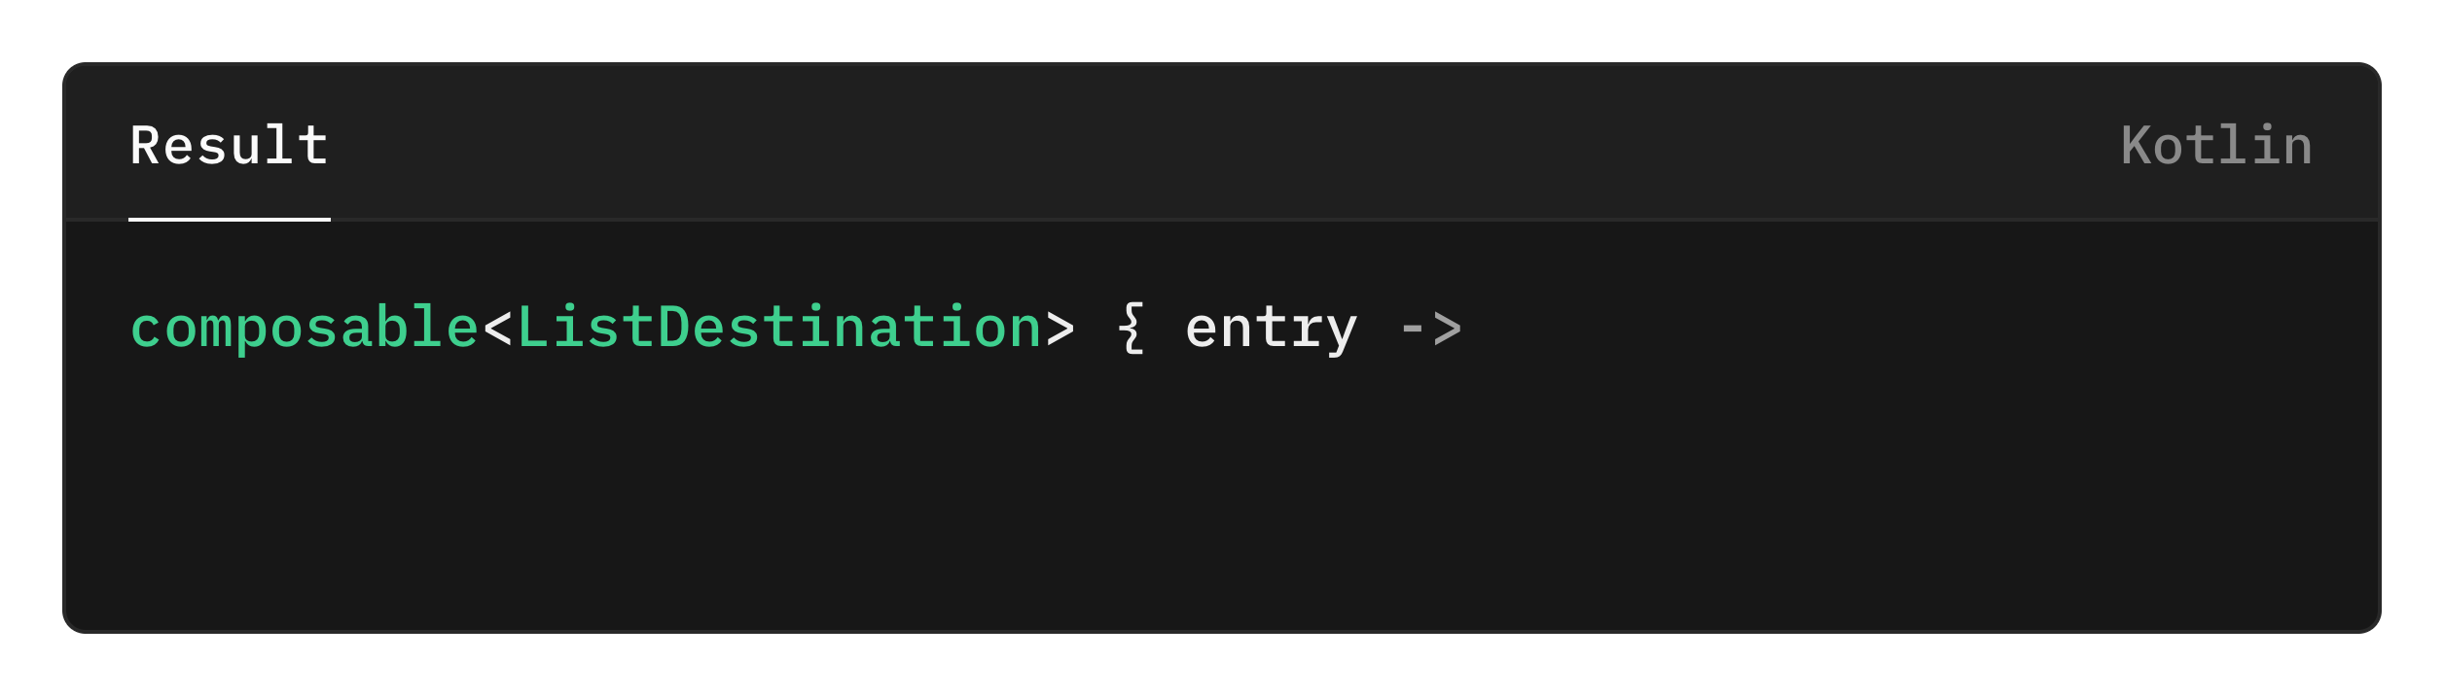

Slide 32
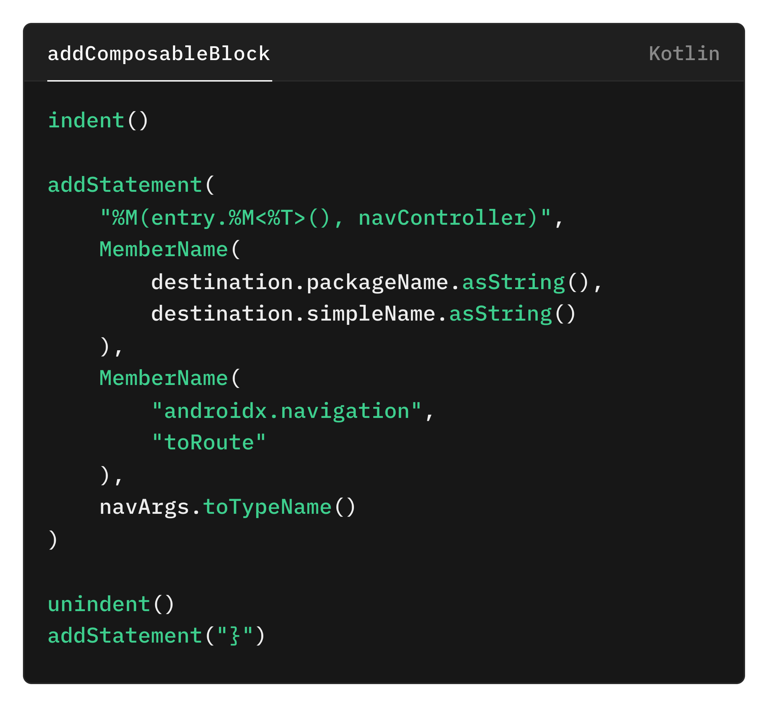
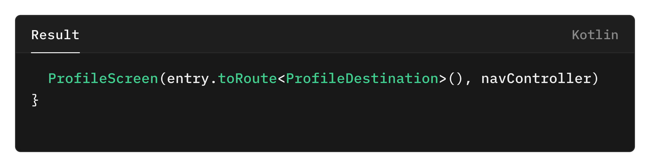

Slide 33
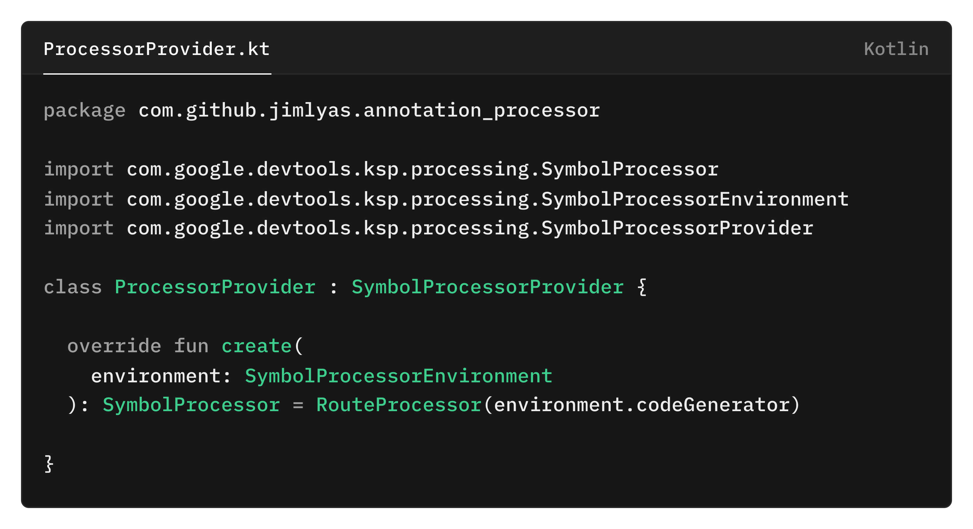
Create ProcessorProvider class

Slide 34
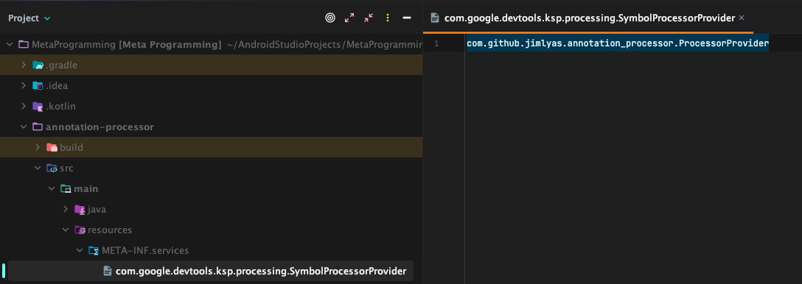
Register the processor provider
Create directory in
src/main/resources/META-INF/services/
Create new file inside it named:
com.google.devtools.ksp.processing.SymbolProcessorProvider
And register the qualified name of the processor provider.

Slide 35
OUTPUT
Let’s see how our code will turn out!

Slide 36
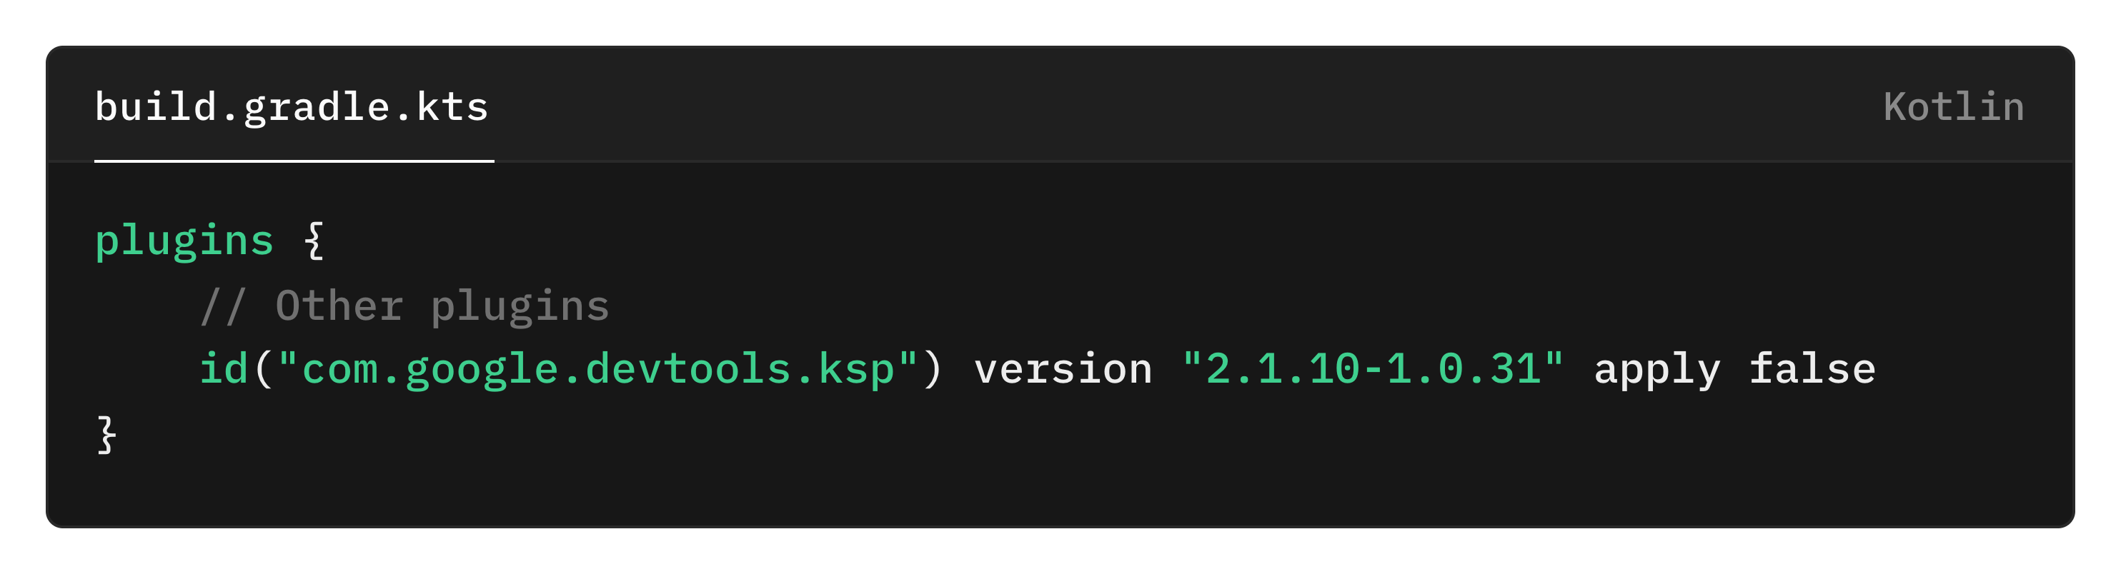
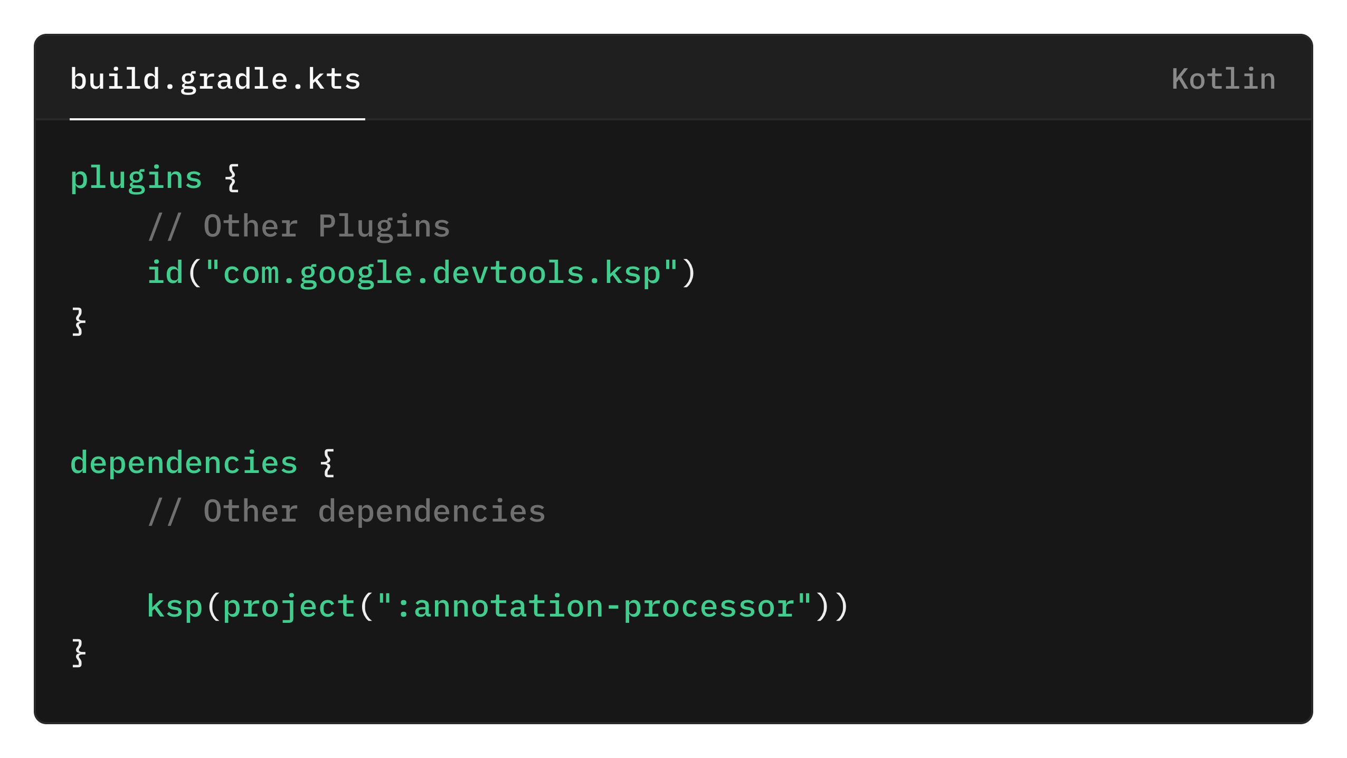
Gradle setup
Root build.gradle.kts
App’s module build.gradle.kts

Slide 37
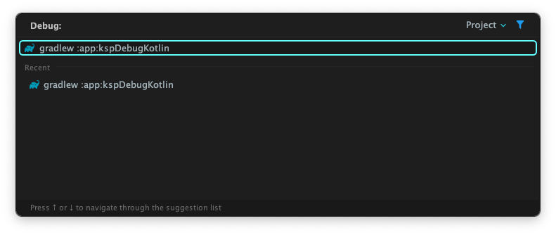
Run the KSP Task

Slide 38
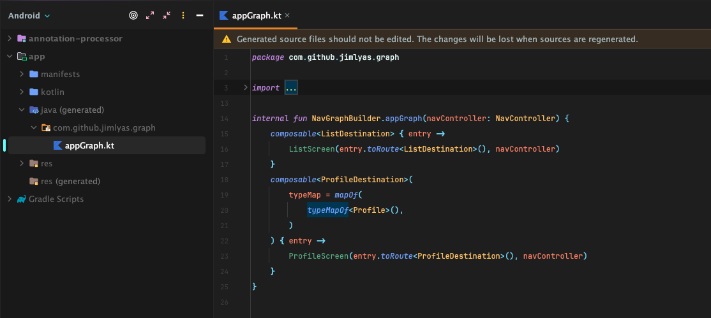
See the generated code

Slide 39
CONCLUSION
What the lesson would be?

Slide 40
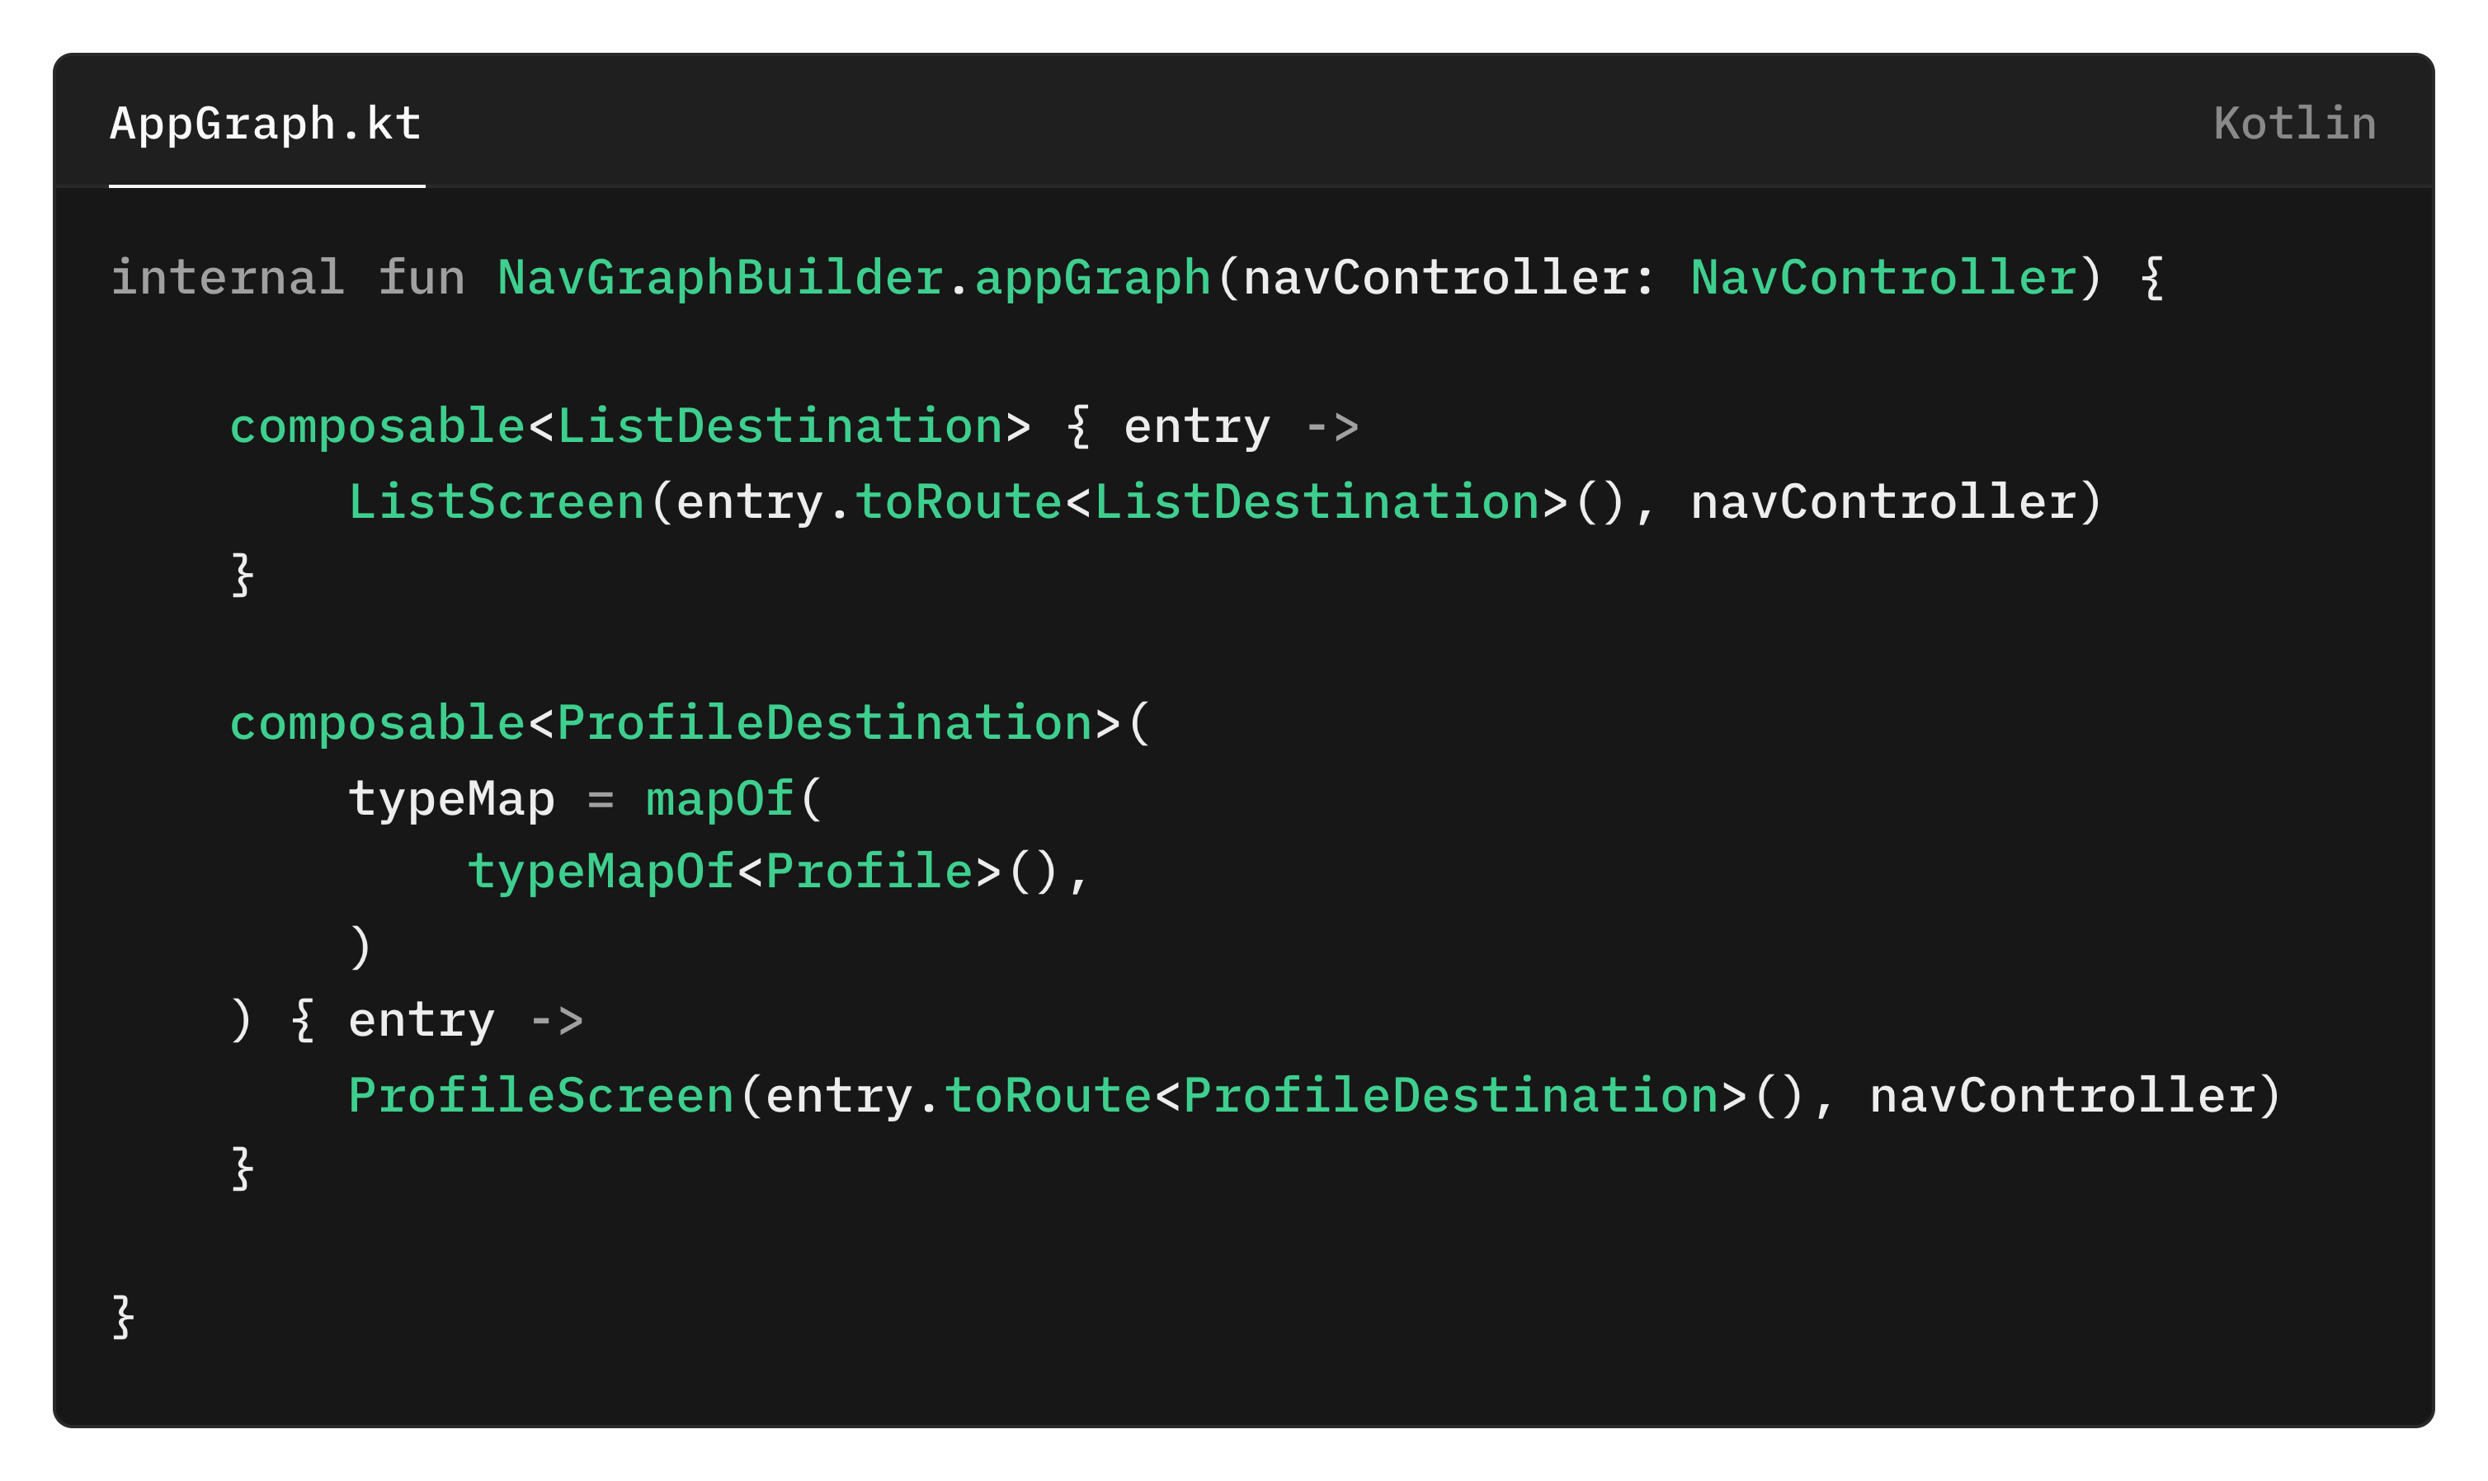
Reduce Boilerplate
Improve Productivity
Automate the generation of boilerplate code.
Less manual coding
=
Fewer errors
Improve Maintainability
Best Performance
Code is always consistent.
Less prone to human error.
Currently KSP along with KotlinPoet is the best combo for meta-programming in Kotlin

Slide 41
Where are going from here?
You can now build your own KSP library or annotation processor.
Furthermore, you can improve the sample processor to:
Handle deeplink
Multi-module navigation
Aggregate NavGraph from another module

Slide 42
QNA
Is there any question?

Slide 43
Thank You
“Code less, Build more.”

